Slide 1
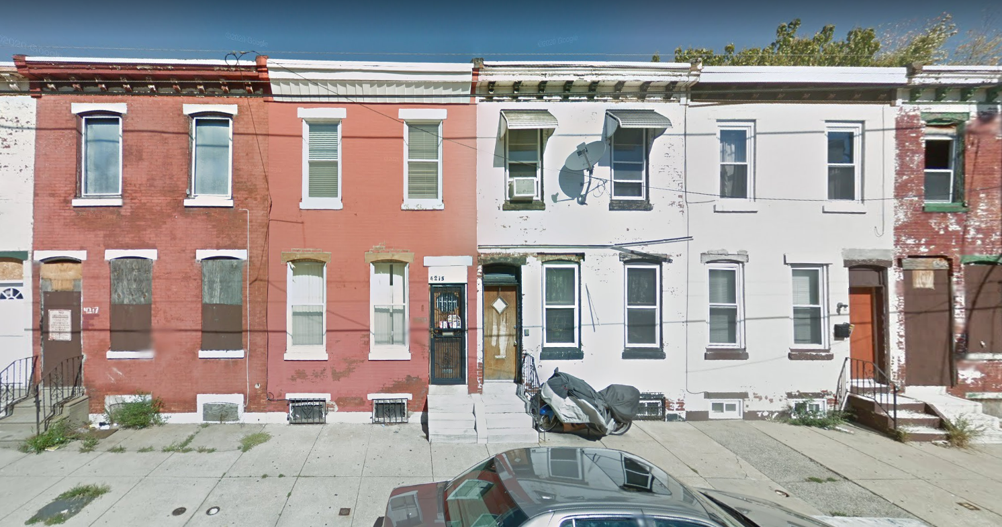
Haverford North, Belmont, and East Parkside
Existing Conditions
Belmont
East Parkside
Haverford North
Existing Conditions | 1.28

Slide 2
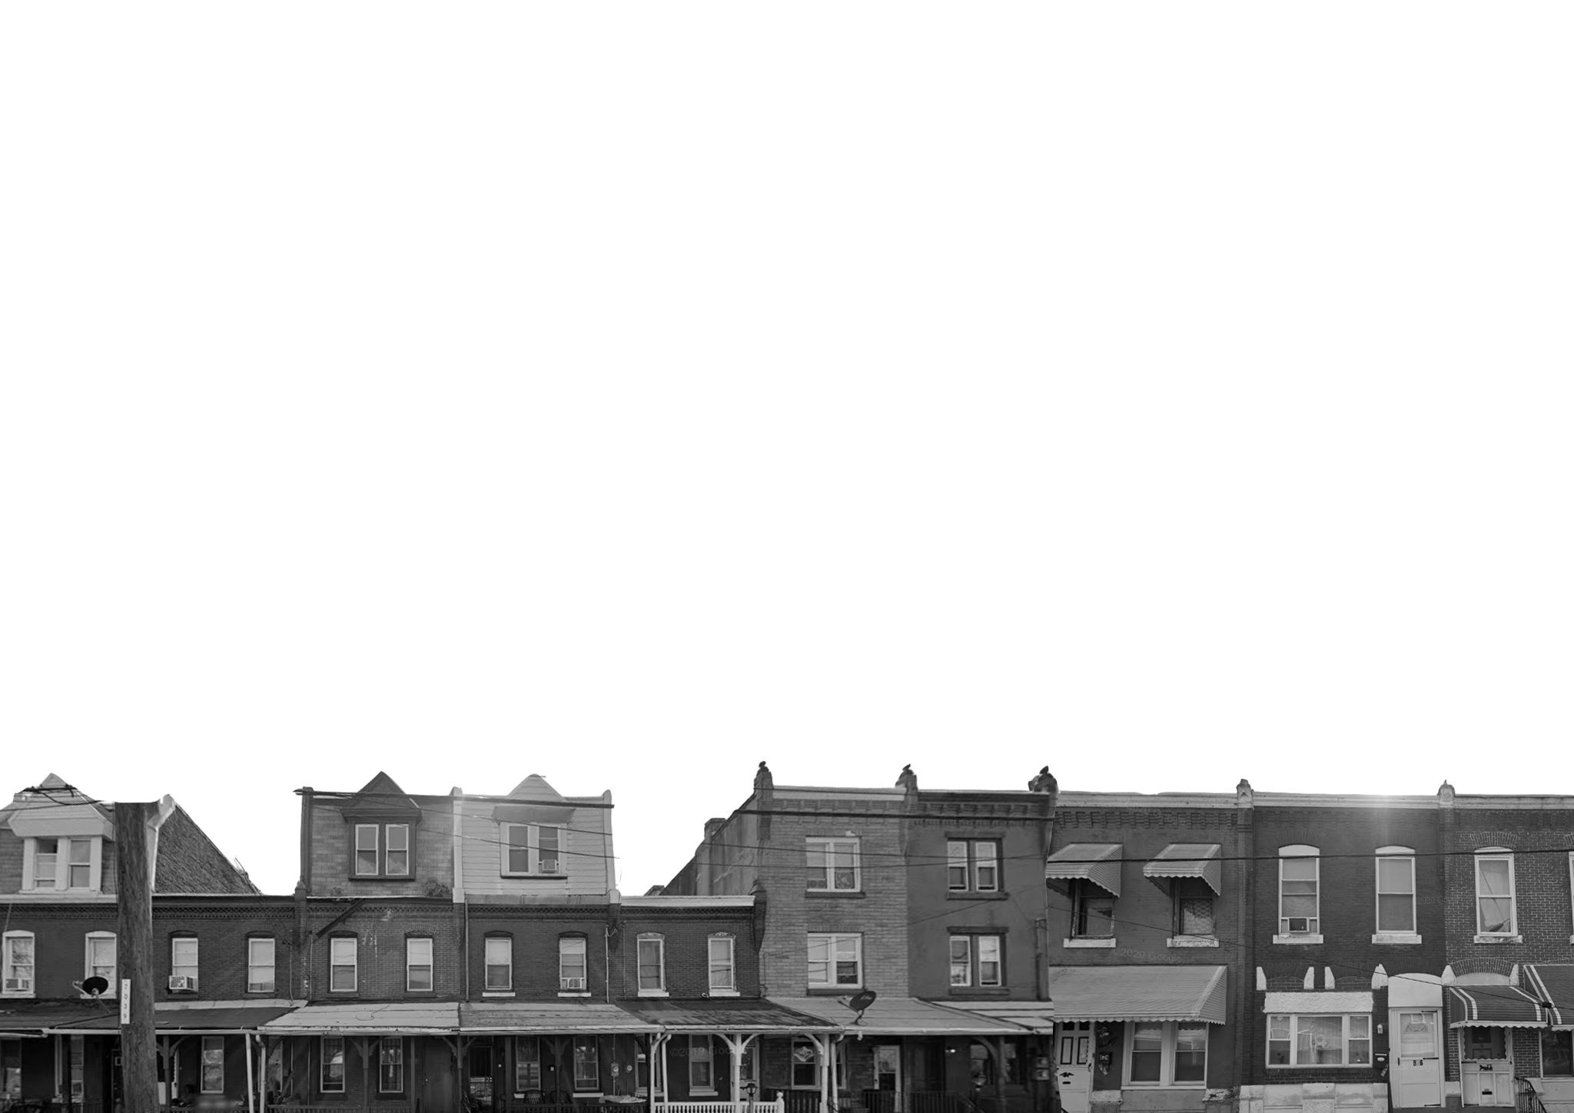
A neighborhood of historic significance that experienced systemic disinvestment starting in the mid 20th century. Today, the area is facing increasing development pressure due to its proximity to anchor institutions in University City
Despite these pressures, the neighborhood is home to a
civically engaged community
that can harness existing assets to promote future resilience, equity, and economic opportunity.

Slide 3
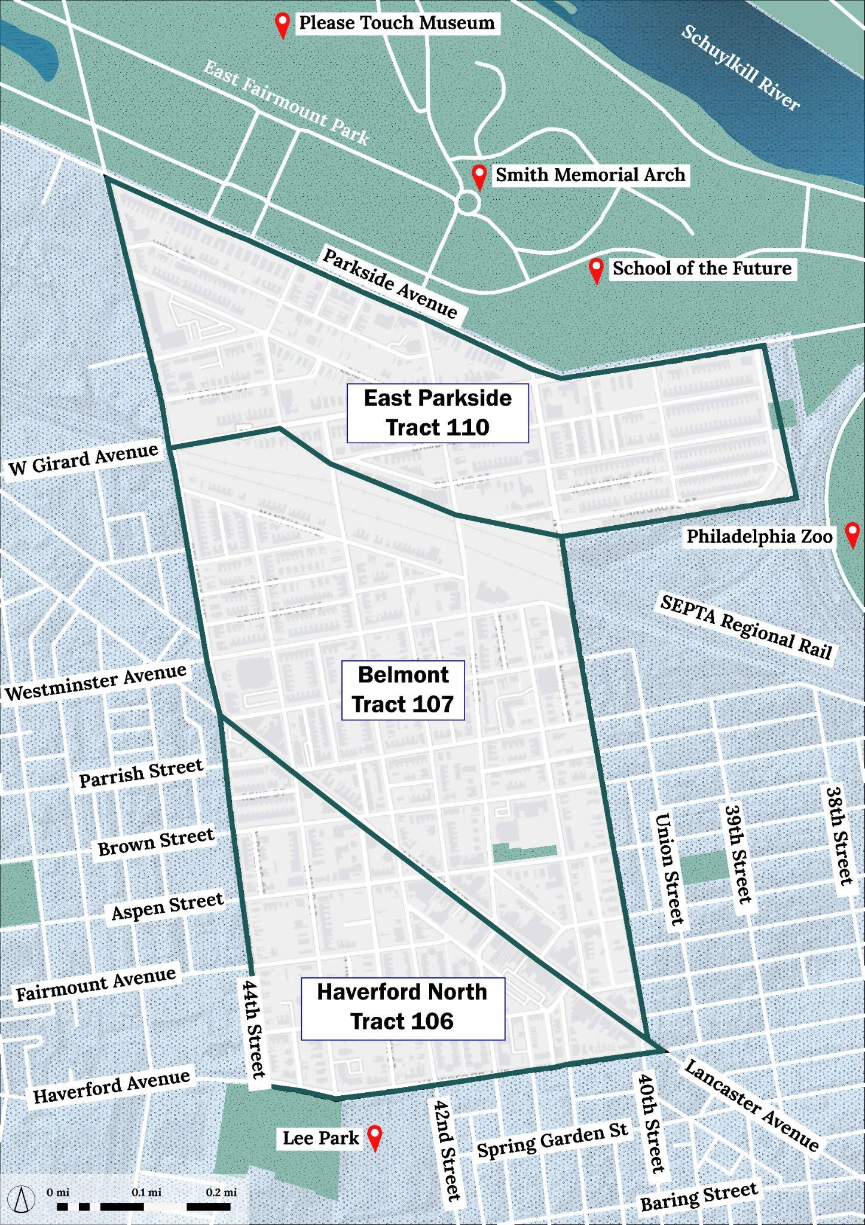
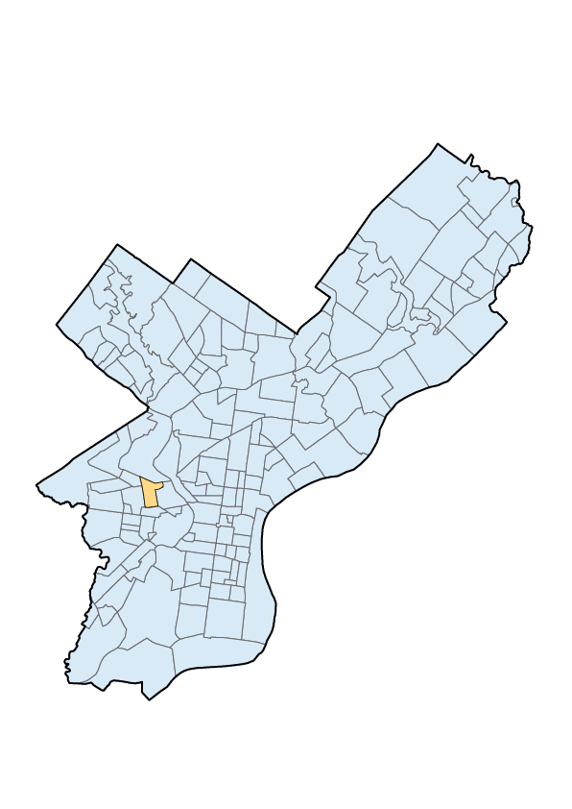
The Study Area
In Philadelphia
Our focus area is comprised of the following 2020 Census tracts:
106 - Haverford North
107 - Belmont
110 - East Parkside
0.4
sq.mi
in area
~8,300
population
Context map

Slide 4
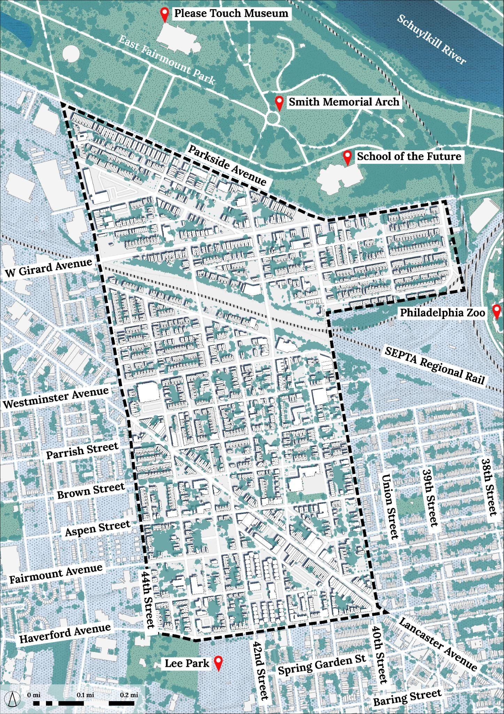
The Study Area
In Philadelphia
Context:
North : Cultural/educational hubs in East Fairmount Park.
South : Drexel University + University of Pennsylvania
Bound by 40th and 44th streets.
Data sources and limitations:
Decennial Census
American Community Survey
5 year estimates
Accounting for COVID-19
Basemap

Slide 5
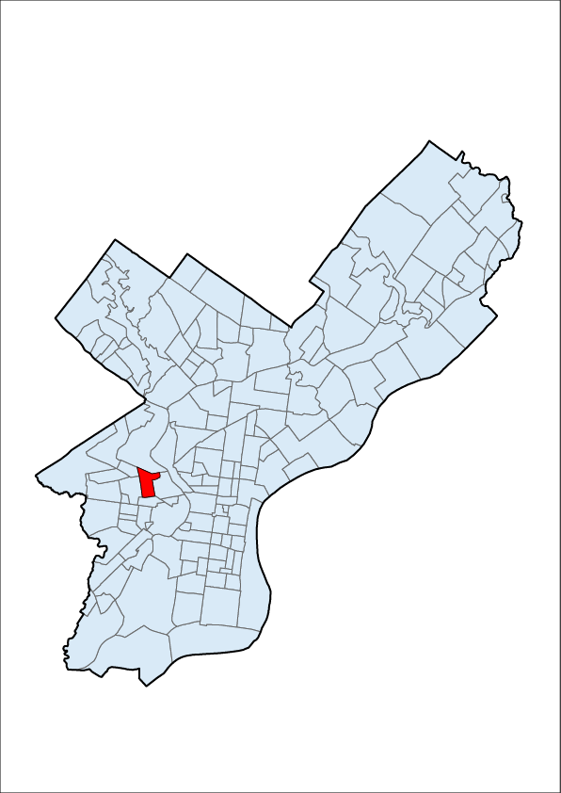
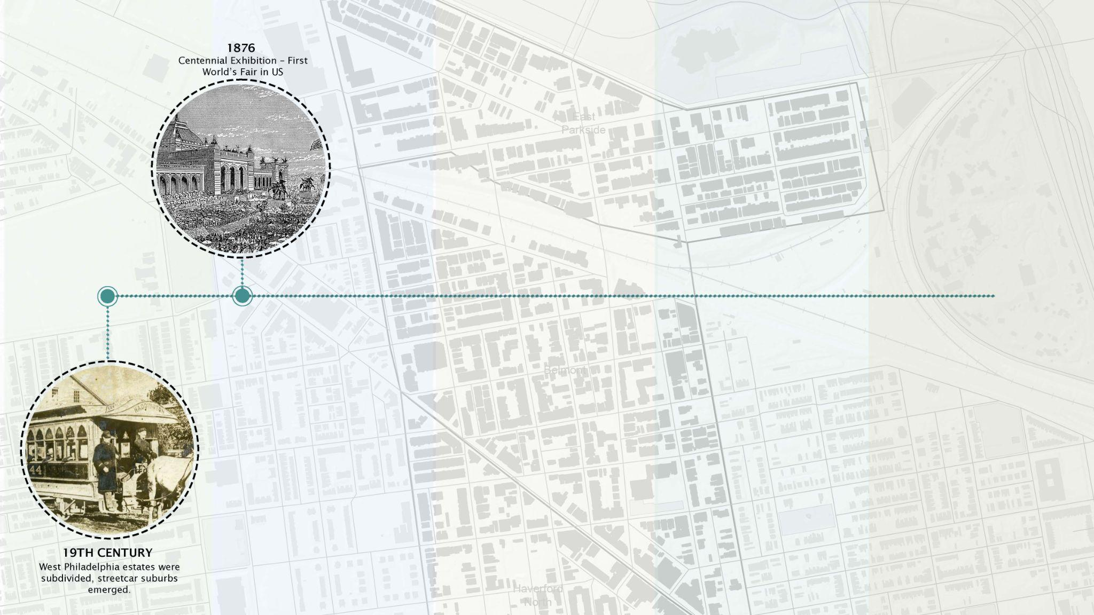
Historic Timeline

Slide 6
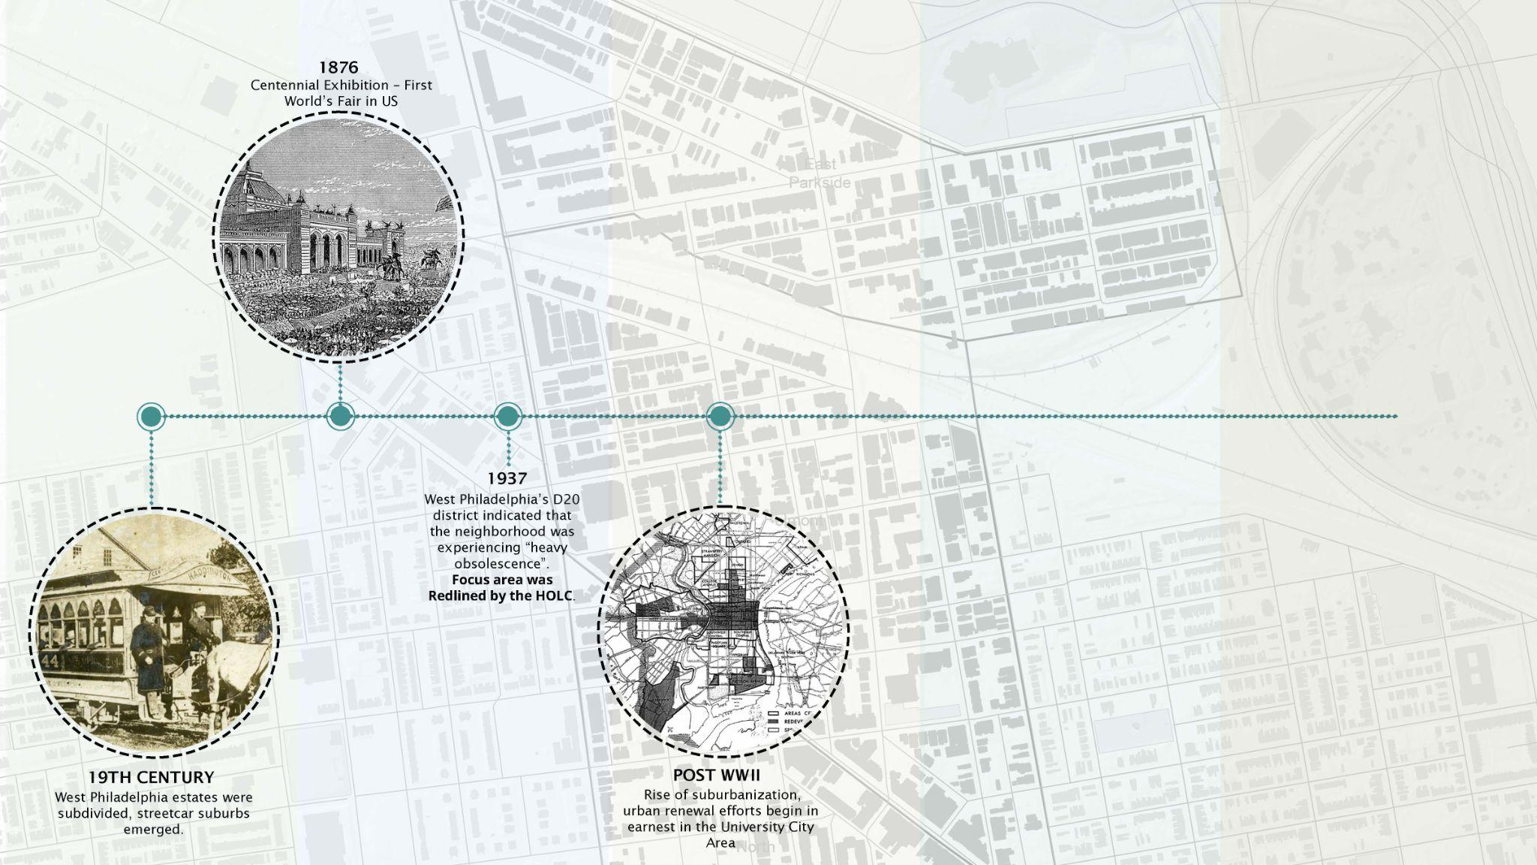
Historic Timeline

Slide 7
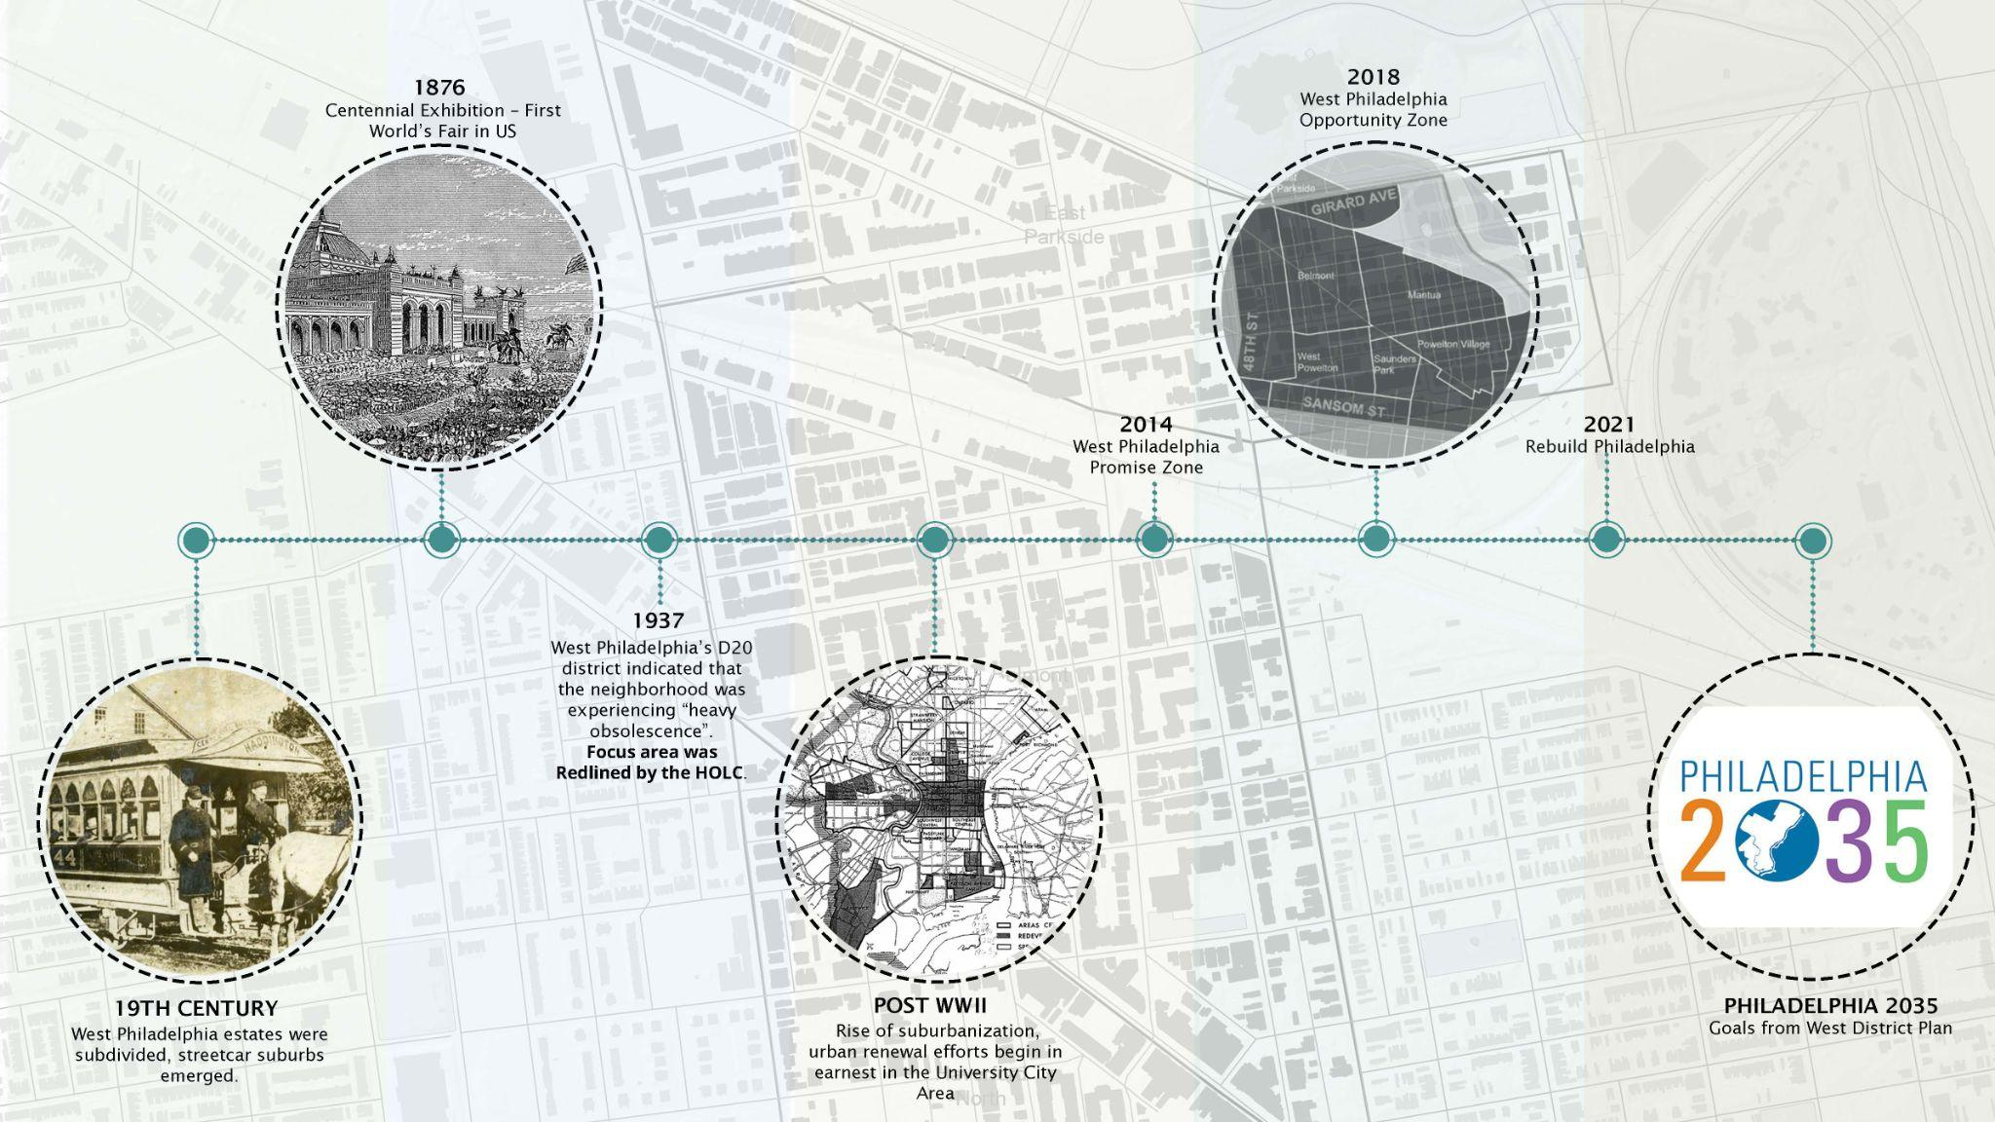
Historic Timeline

Slide 8
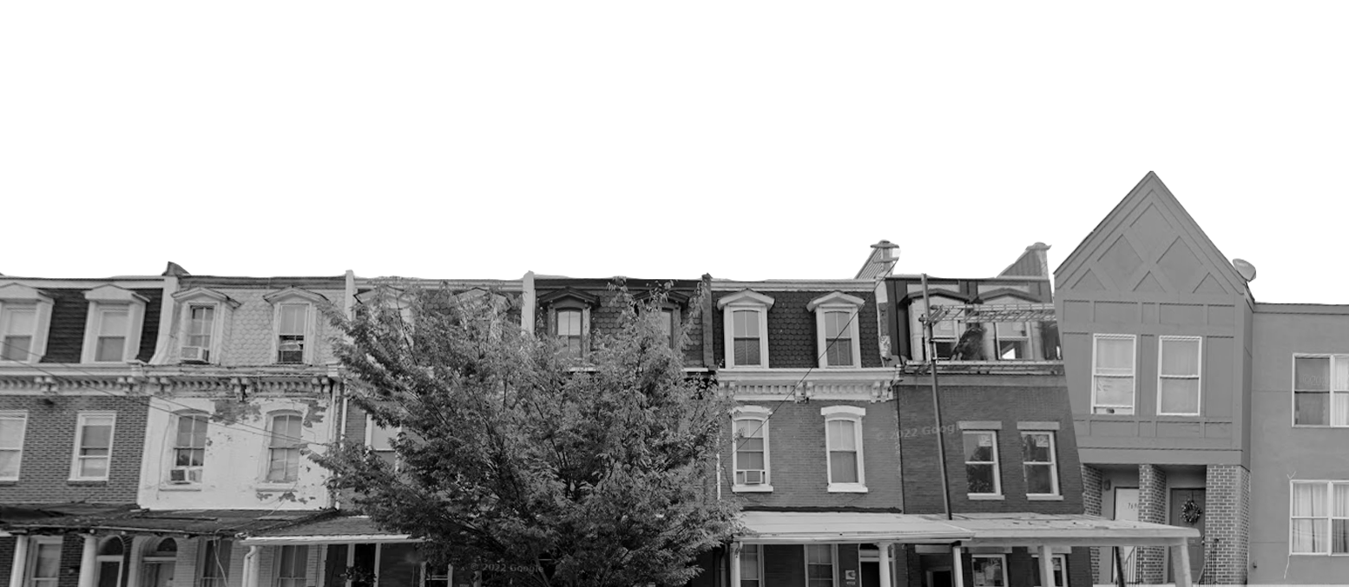
Demographic Studies

Slide 9
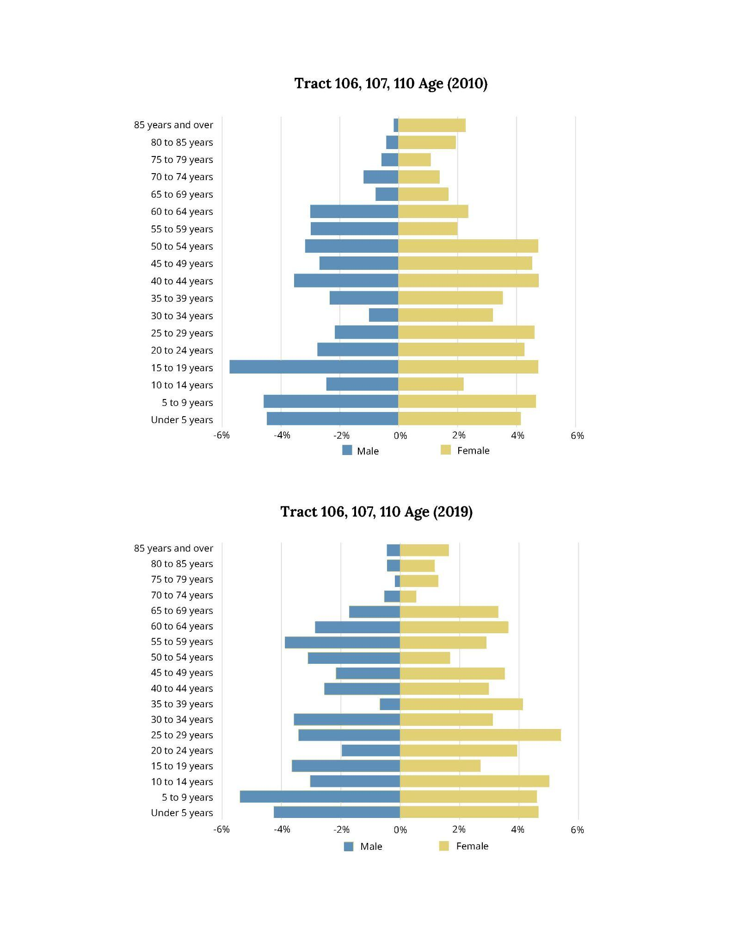
Growing Elderly & Youth Population
Demographics : Age
27%
Children below 15, only 19% in Phl
-41%
Population loss between 35-45,
+4% in Phl

Slide 10
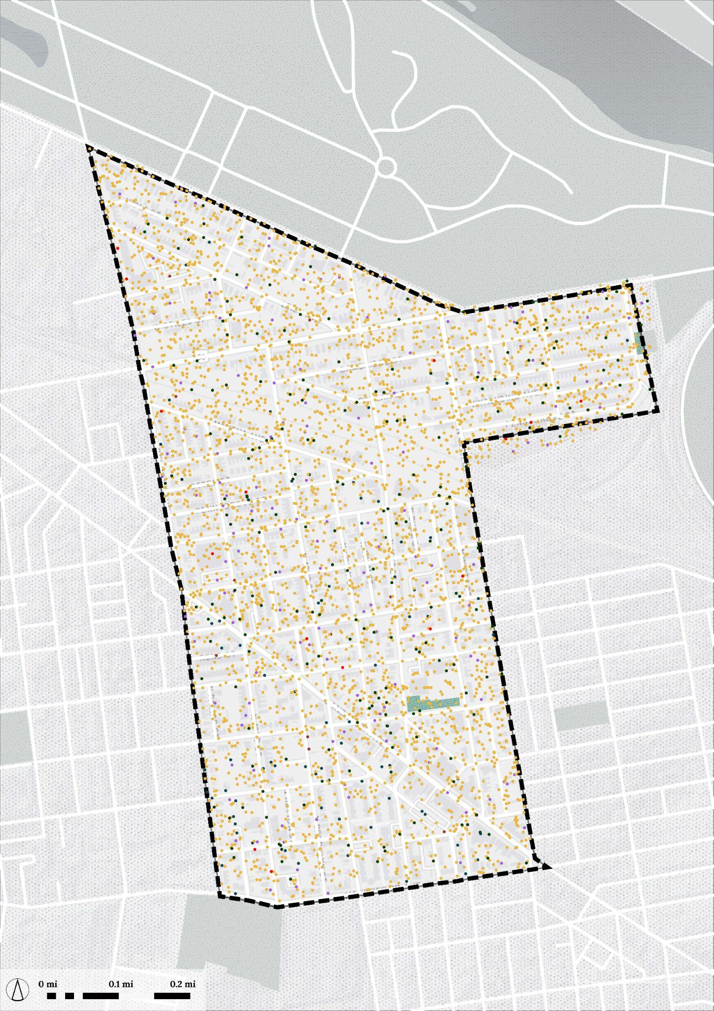
Growing More Racially Diverse
Demographics : Race
~85%
Black Population in 2019. It was 93% in 2010.
~3x
Asian population - from 52 to 152 between 2010 and 2019.
+76%
Hispanic population increased from 192 to 338.
~2x
Population with two or more races.
The population trend reflects the overall trend in Philadelphia.
Black
Asian
White
Other
Dot Density Map
1 dot = 3 people

Slide 11
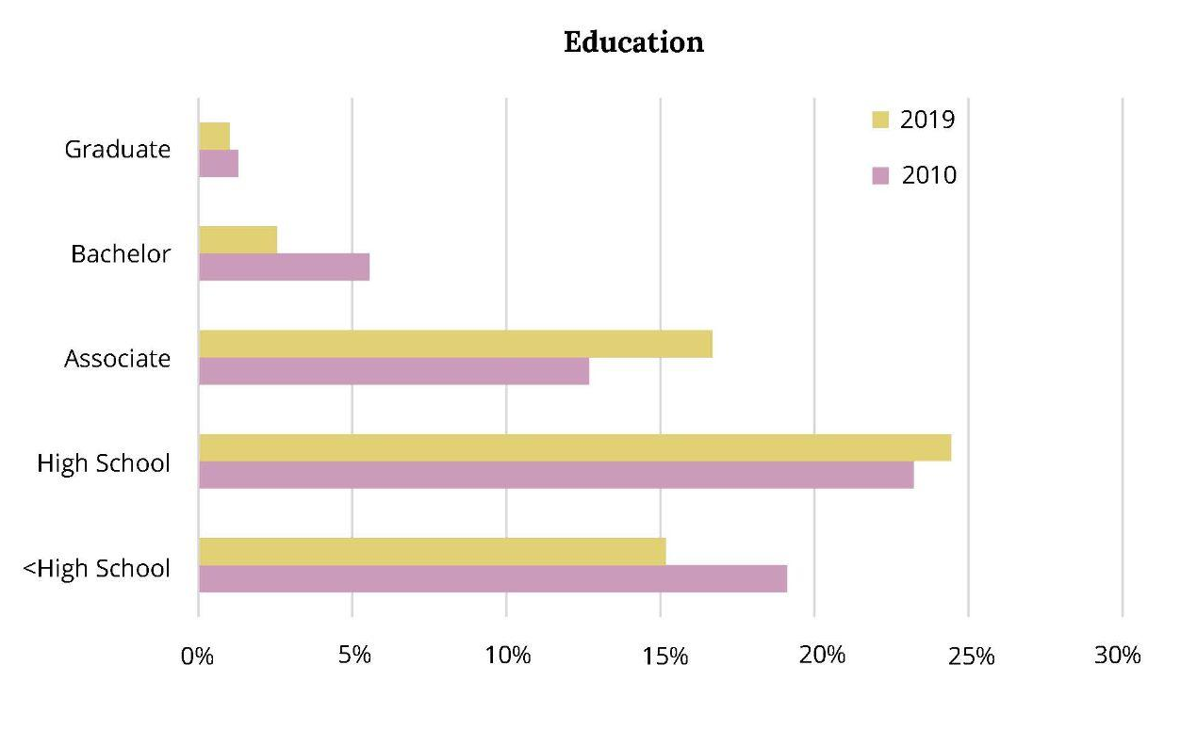
A Neighborhood of Single Mothers
Demographics : Household & Education
~3100
Households
66%
Single-mother
Households
(Among family households)
37%
In Philadelphia
~54%
Family Household
The number of households remained constant from 2010 to 2019.
Improved education attainment, but the study area is losing people with higher education attainment.
-13%
Population with bachelor or higher degrees
+6%
In philadelphia

Slide 12
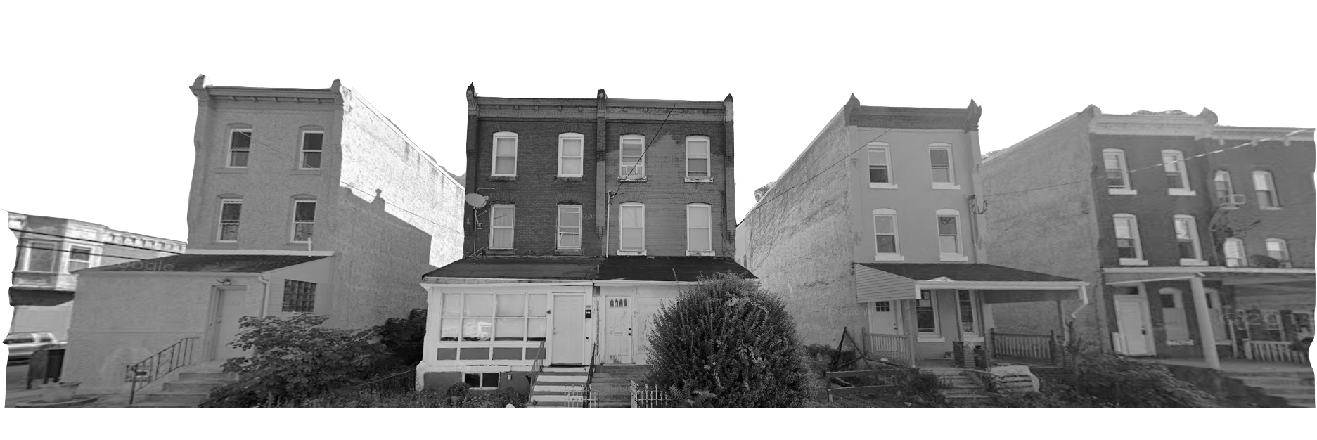
Development Pressures

Slide 13
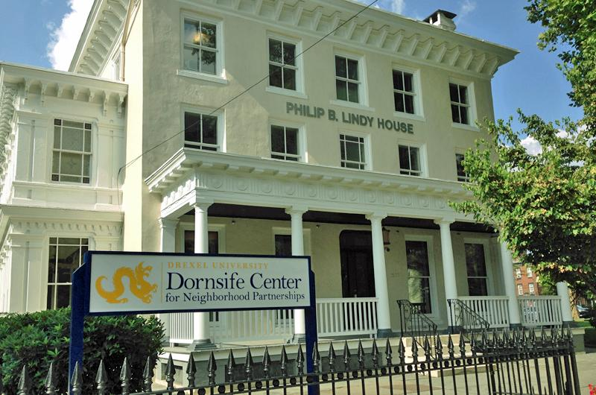
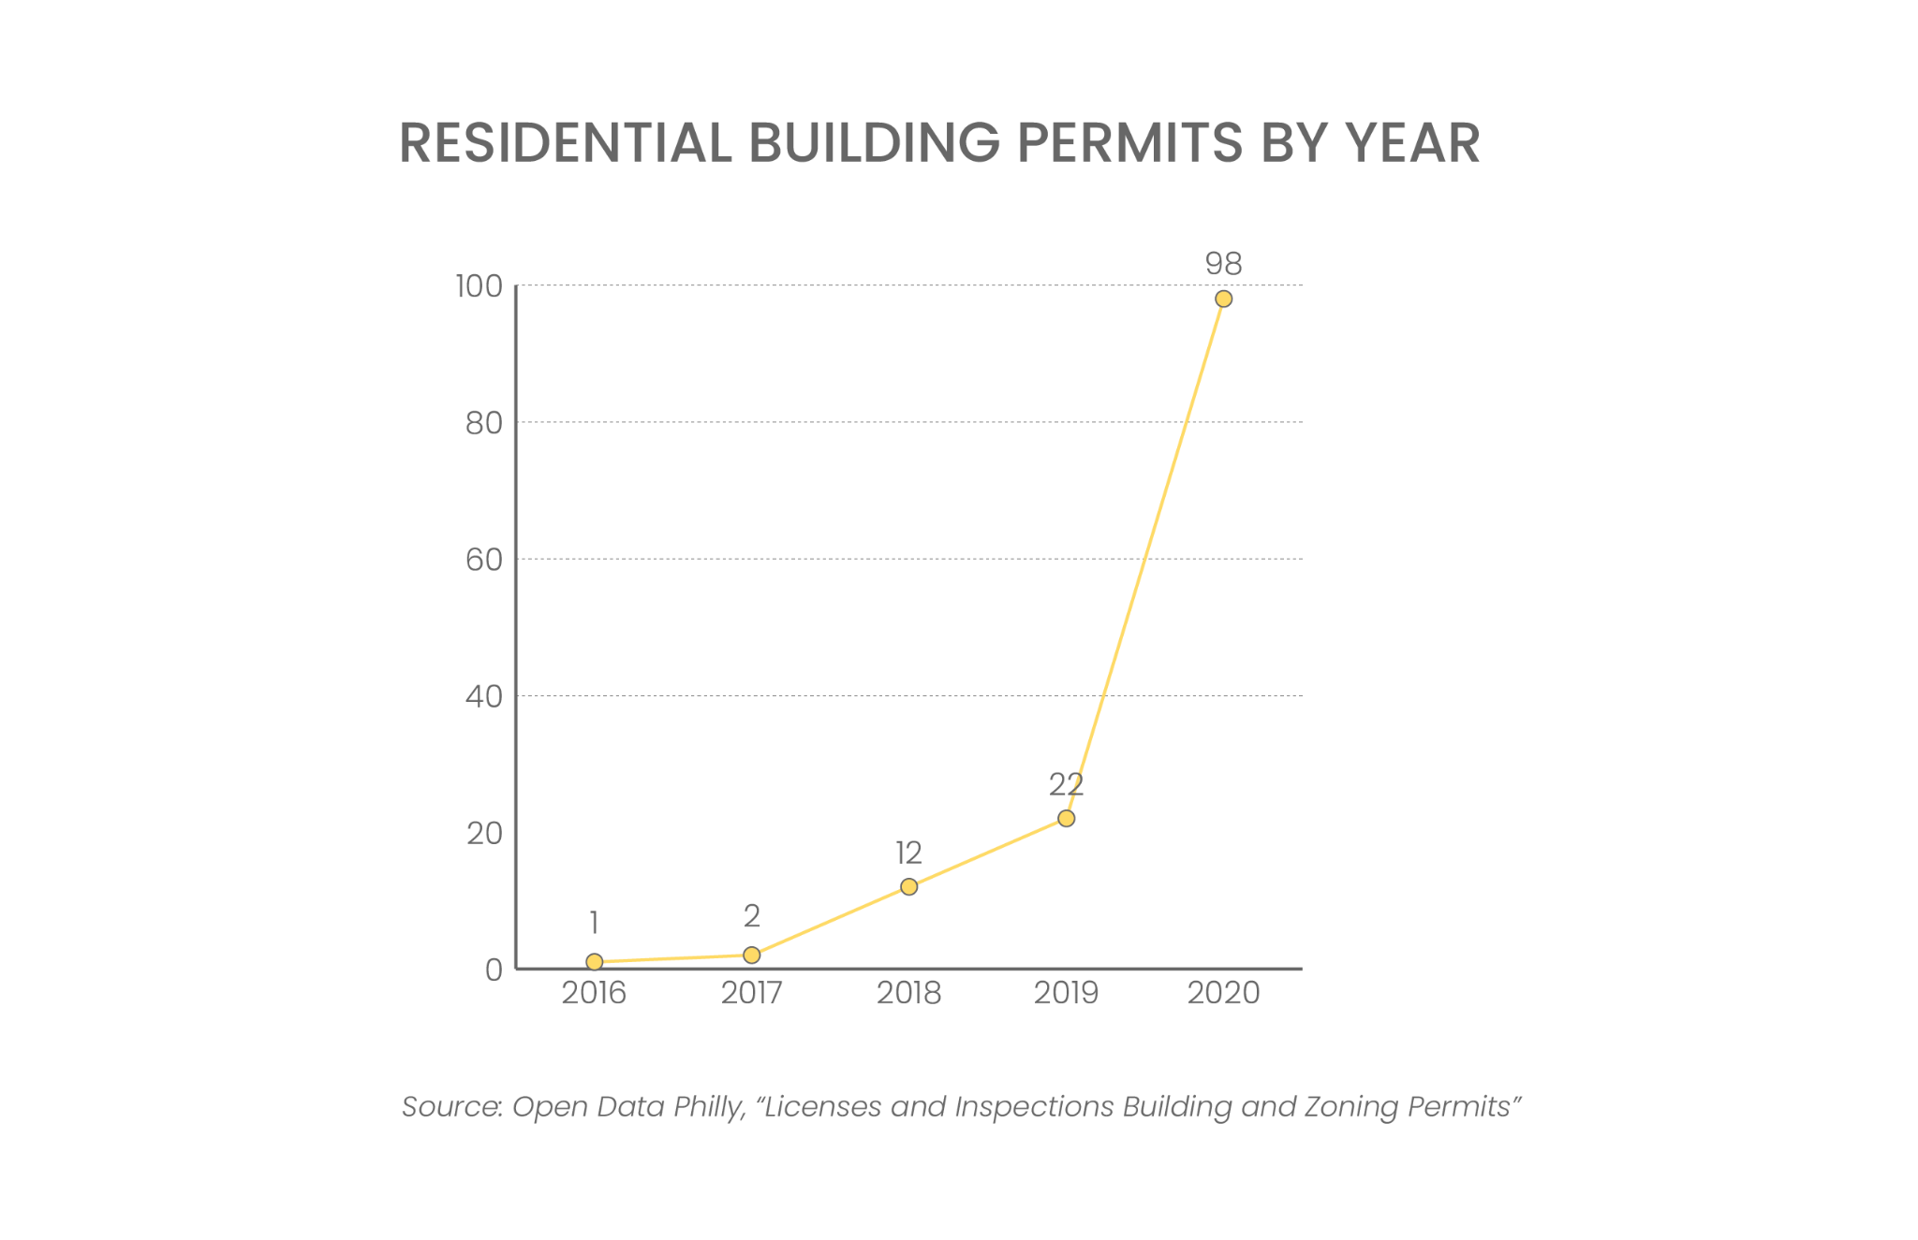

Penn & Drexel Effect
Development Pressures: Anchor Institutions
Drexel’s President John Fry driving community development
Dornsife Center opened in 2014
Focus area potentially poised to follow development trends experienced in Mantua
Sources: https://drexel.edu/dornsifecenter/news/news-archive/2014/September/Law-Clinic/;
https://drexel.edu/now/archive/2015/July/Dornsife_Center_Qtrly/

Slide 14
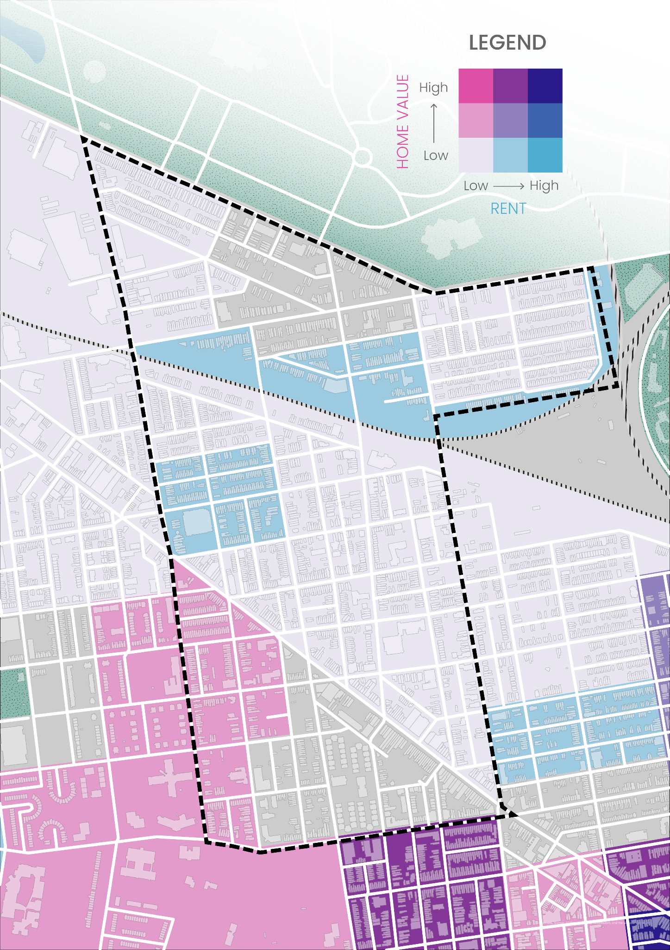
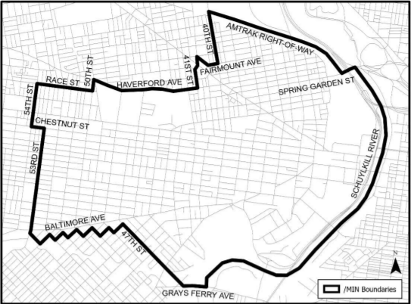
Penn & Drexel Effect
Mixed Income Neighborhood Overlay District
Passed by City Council In December 2021
Mandates inclusionary zoning minimums for new residential developments
Home value vs rent map
Source: City of Philadelphia Bill No. 210633-A02

Slide 15
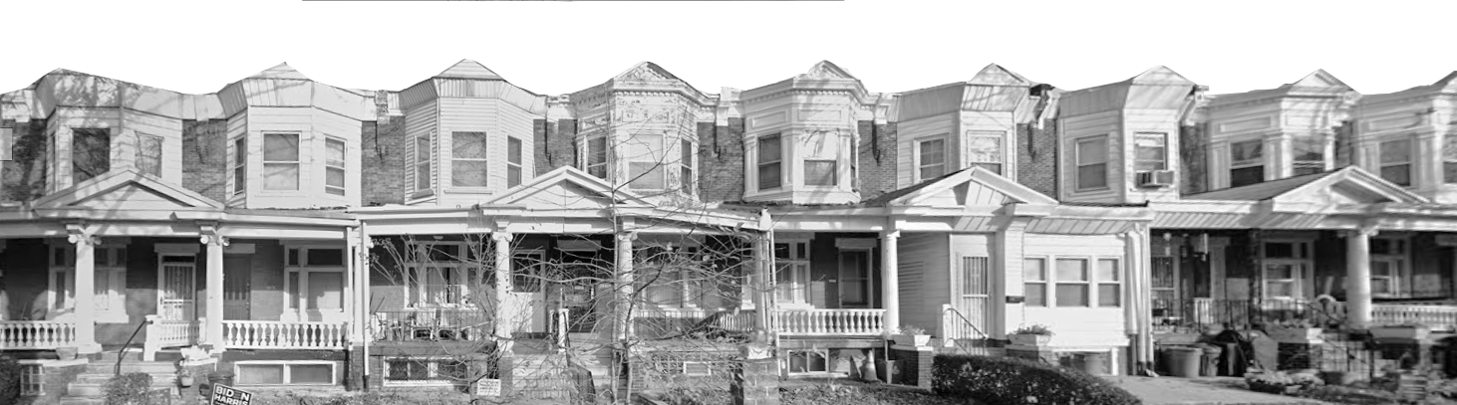
Economic Analysis

Slide 16
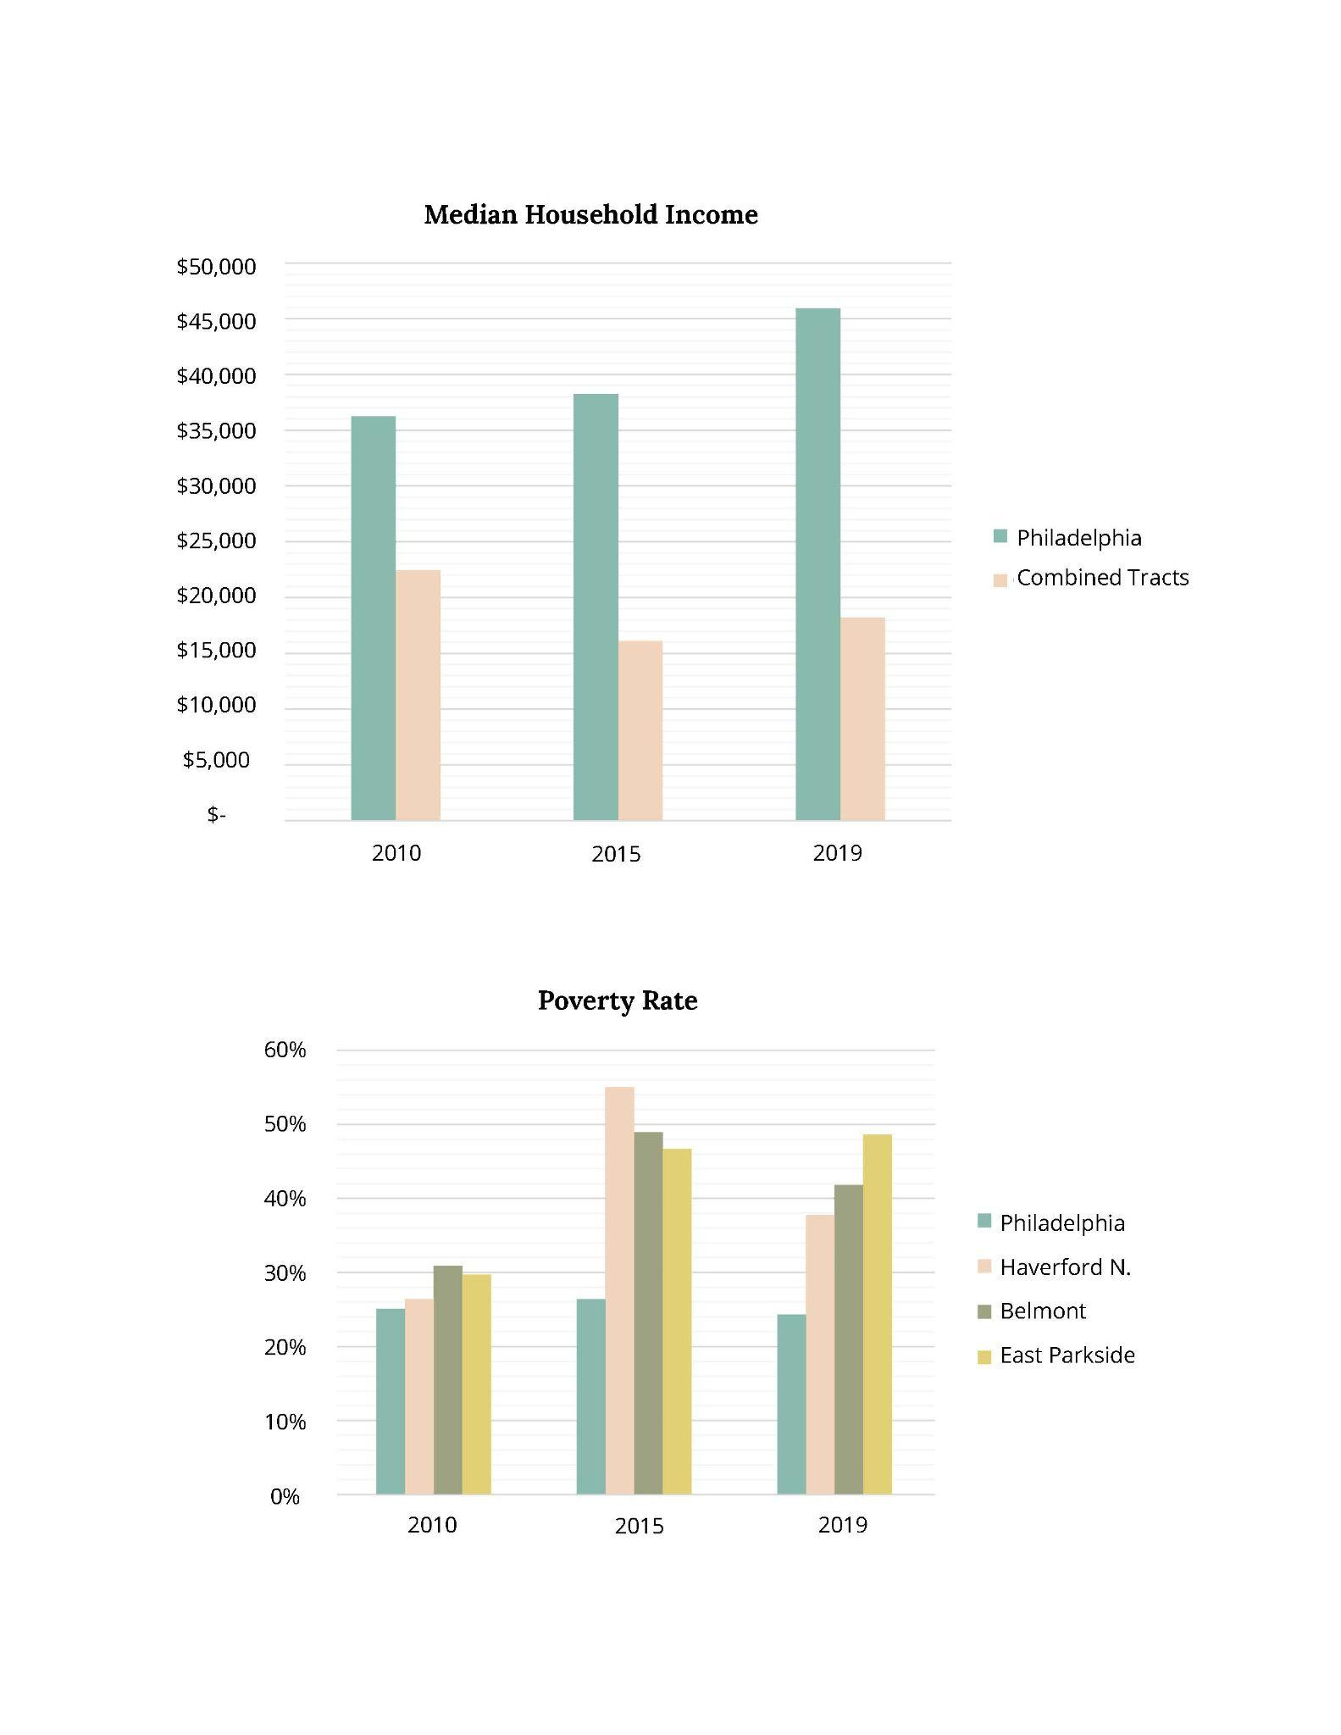
Low Income and High Poverty
Economics : Income and Poverty
$18,172
Median Household Income
(2019)
$45,927
In Philly
(2019)
42% Population below poverty

Slide 17
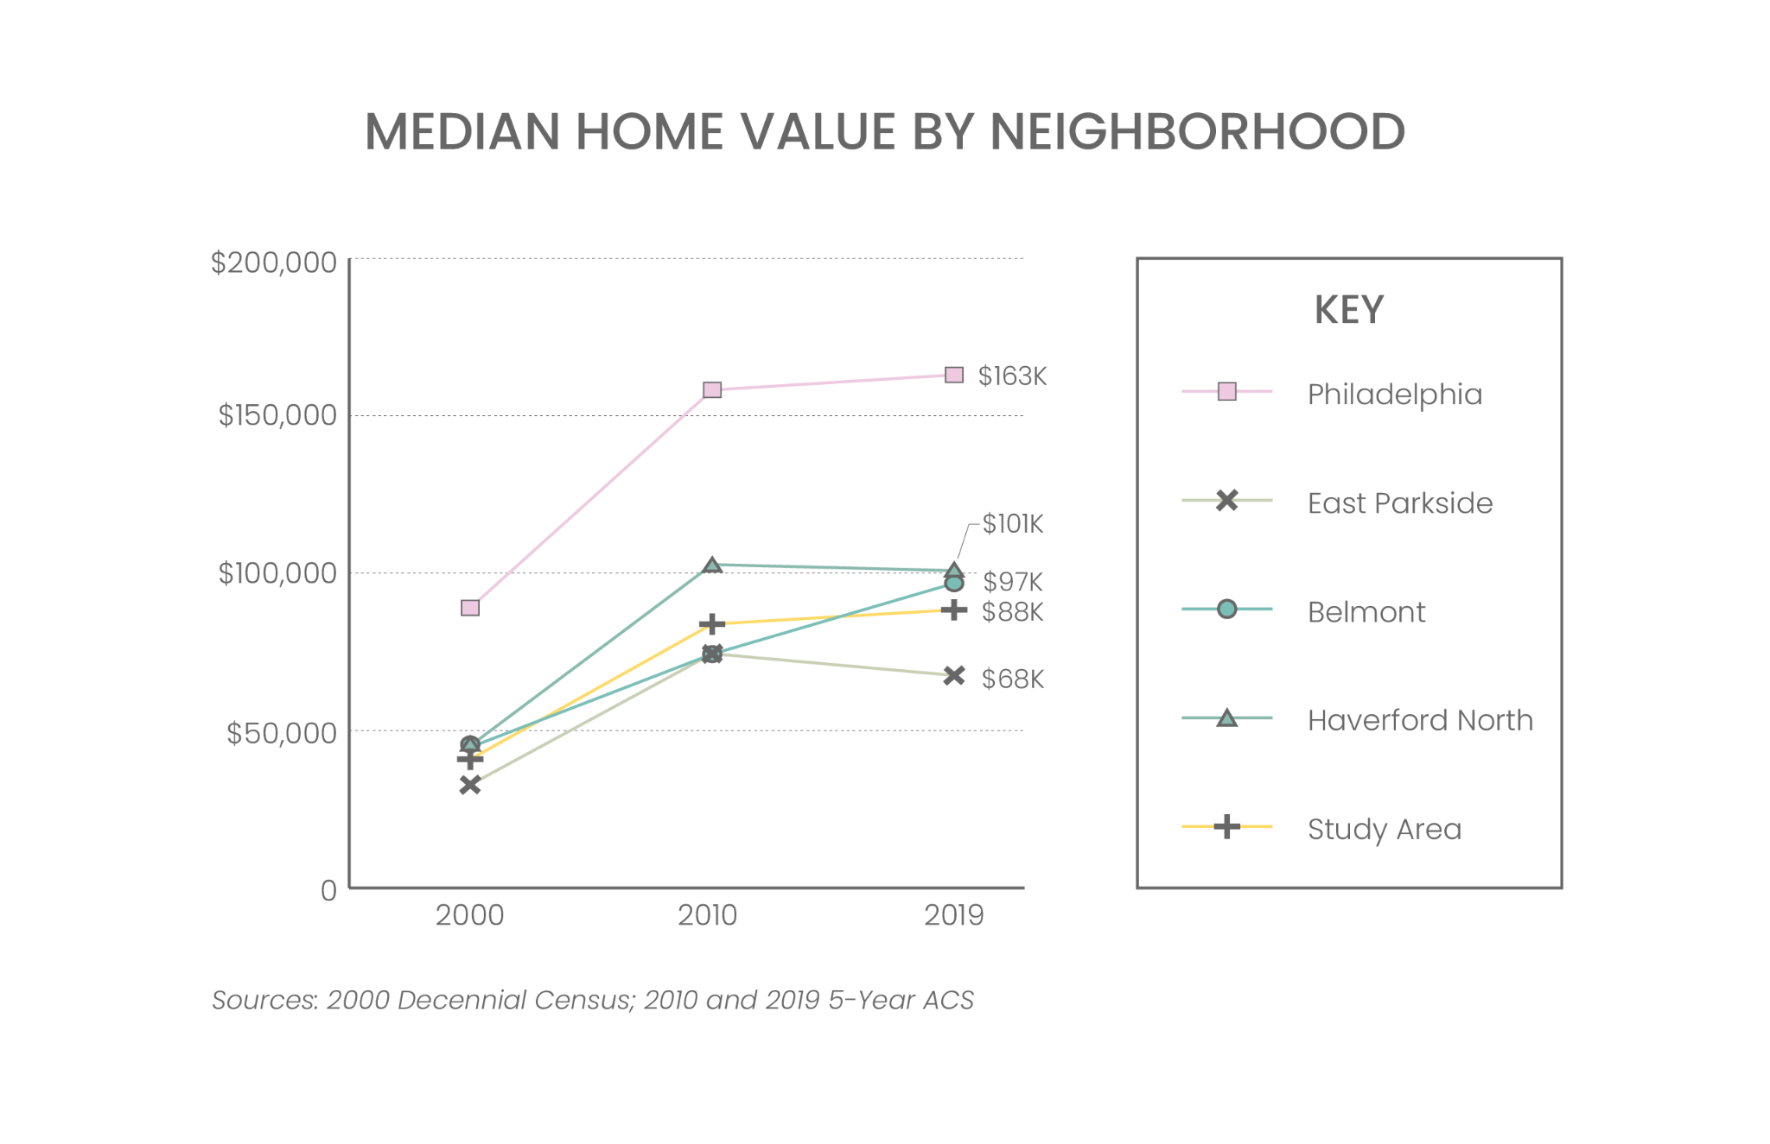
Large Share of Affordable Housing
Economics : Housing Affordability
$88K Median Home Value
54% lower than Philadelphia
4%
Of City Public Housing
0.7%
Of City
Housing Stock

Slide 18
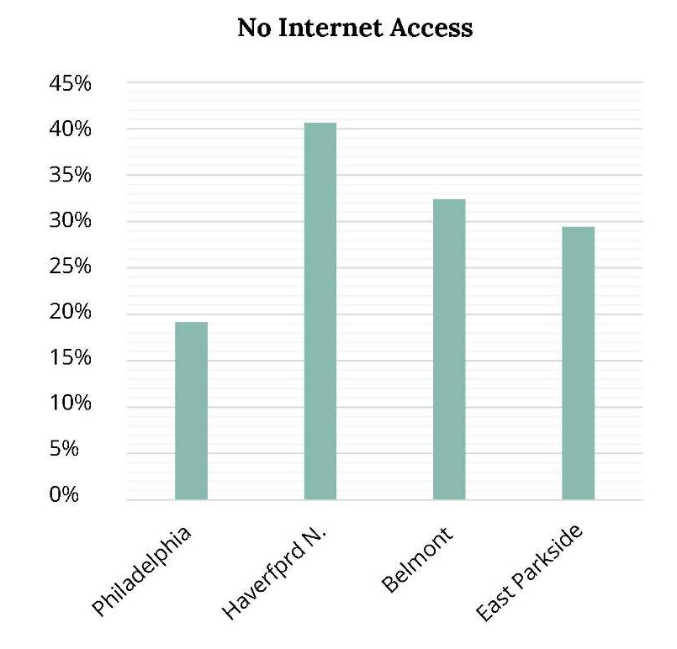
Digital Divide
Economics : Internet Access
“The idea of the "digital divide" refers to the growing gap between the underprivileged members of society [...] who do not have access to computers or the internet; and the wealthy, middle-class, and young Americans living in urban and suburban areas who have access.”
- Stanford University https://cs.stanford.edu/
32.5%
No Internet Access
19.15%
No Internet Access in Philly

Slide 19
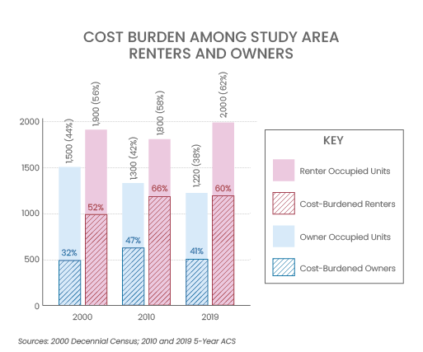
…But High Cost-Burden
Economics : Housing Affordability
62% Renter households
38% Owners
1.2x
More cost-burdened homeowners than Philly
69%
Renters are cost burdened in East Parkside

Slide 20
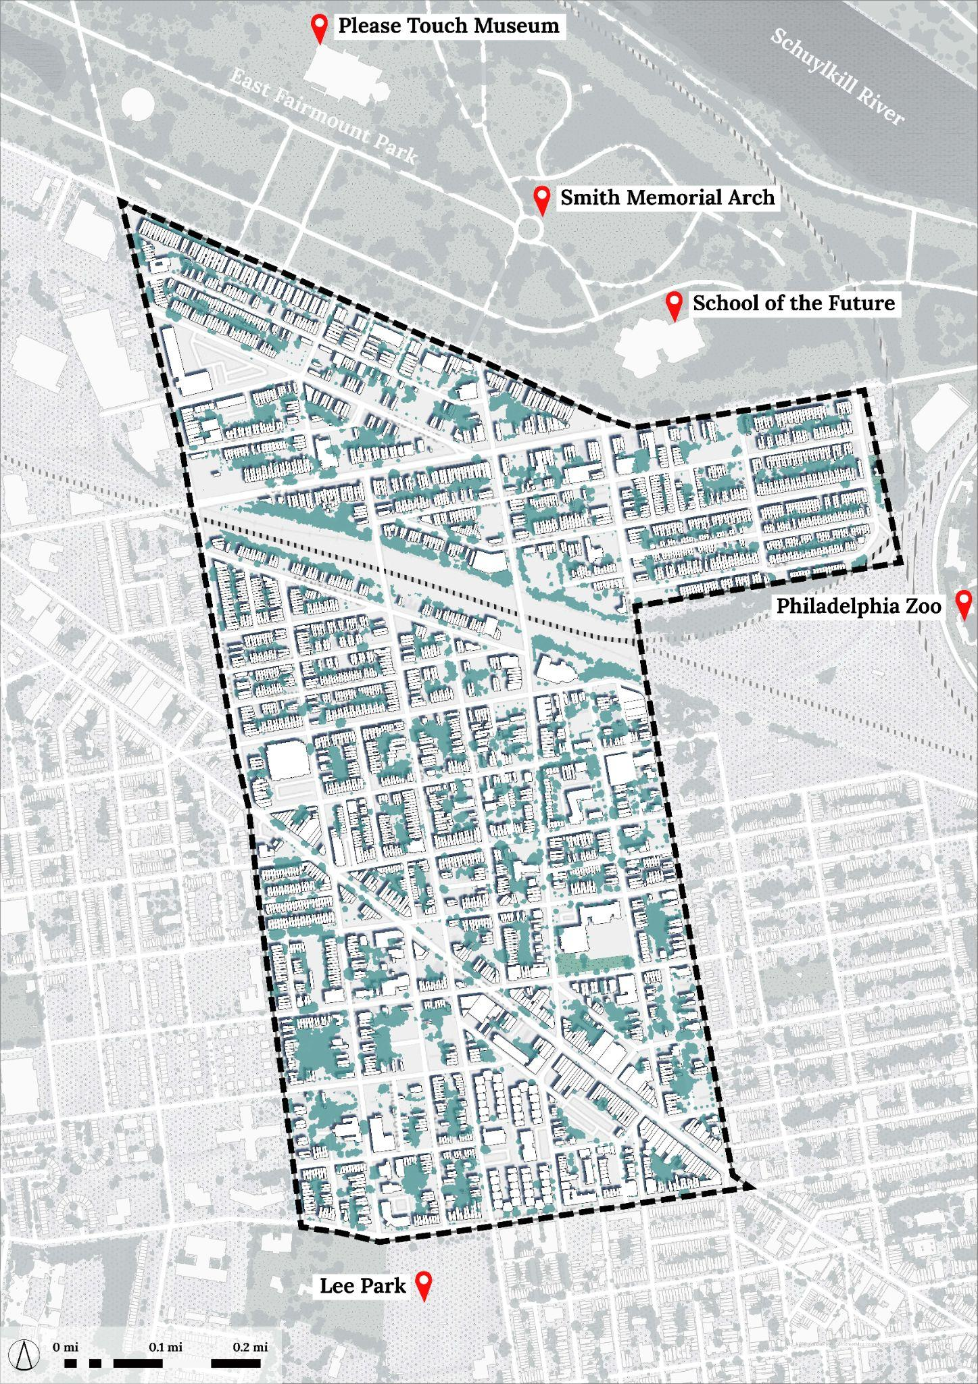
Increased Inflow & Outflow of Jobs
Economics : Employment
How many are going out?
2,823 residents, 99% of the resident labor force.
Where are these going?
9% head to Tract 369 (University of Pennsylvania and Hospital) & Tract 4.02 (City Hall commercial corridor).
How far are the going?
74% of employed residents work within less than 10 miles of their home, the majority commuting Southeast.
How many stay within?
37 residents, 1%, fill internal jobs.
How many are coming in?
719 internal jobs are filled by external workers commuting into the neighborhoods.
719
37
2,823

Slide 21
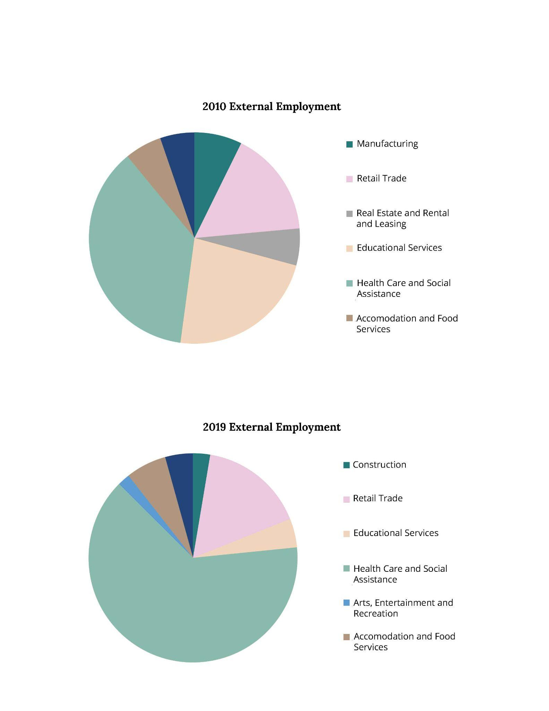
Shifting Industry Sectors
Economics: External Employment
External Employment
2010
2019

Slide 22
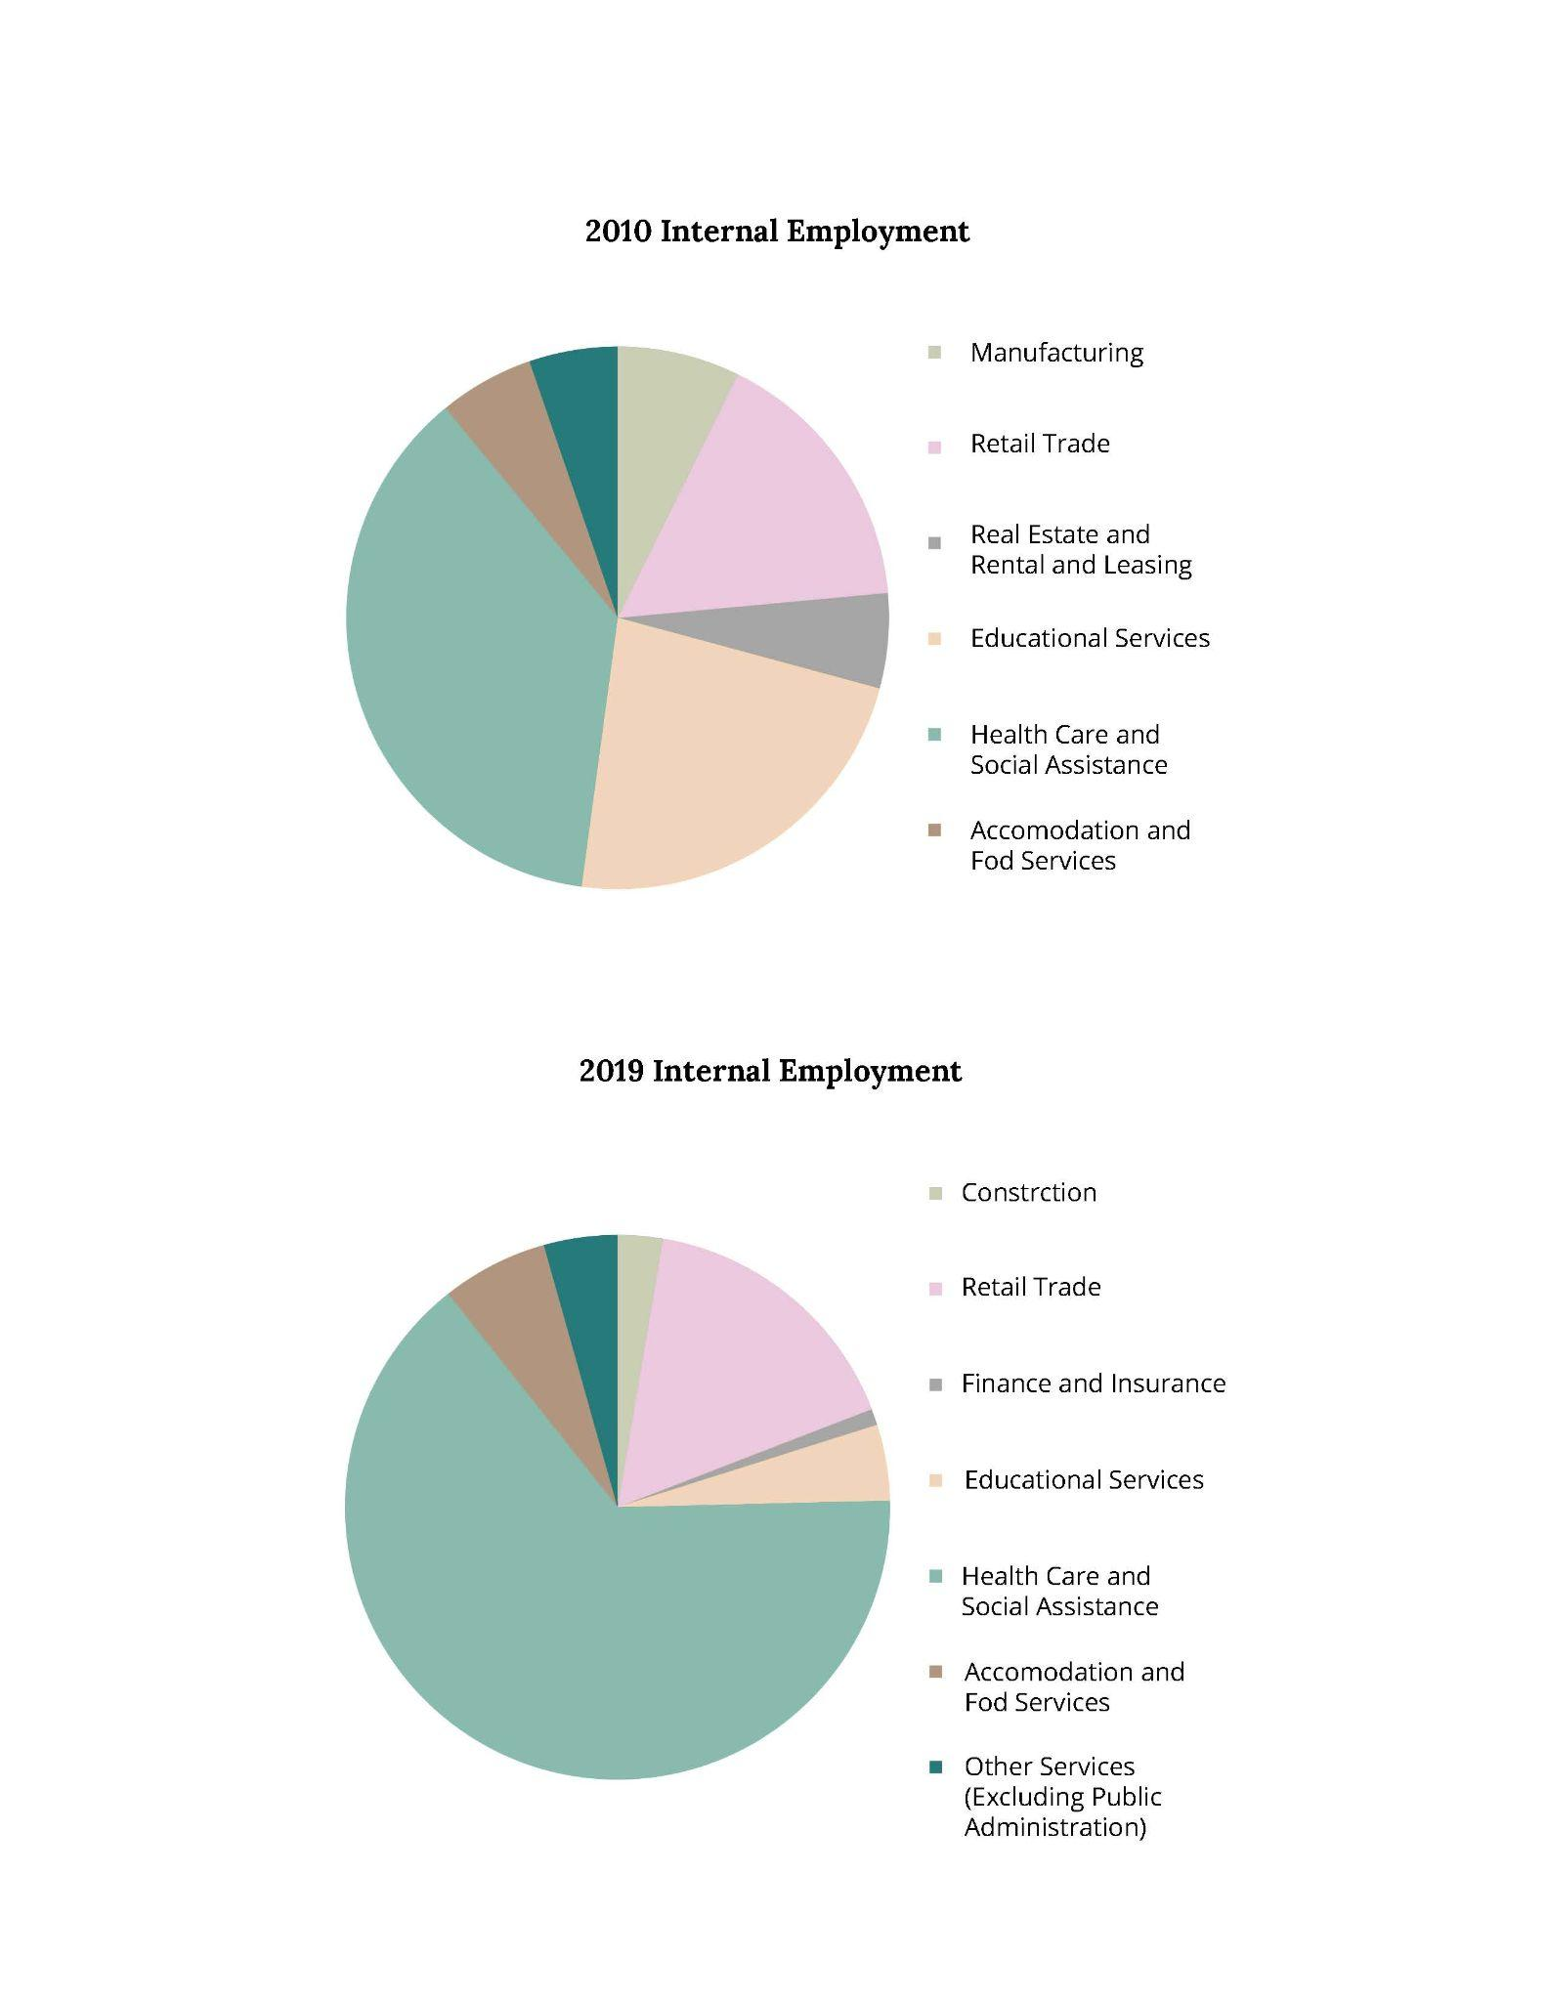
Shifting Industry Sectors
Economics: Internal Employment
Internal Employment
2010
2019

Slide 23
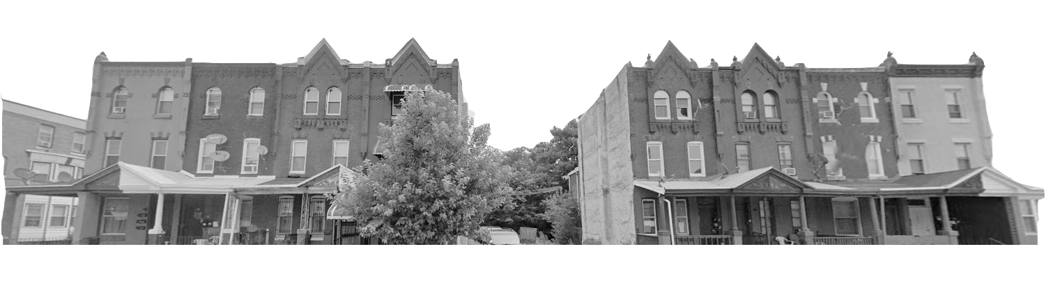
Transportation

Slide 24
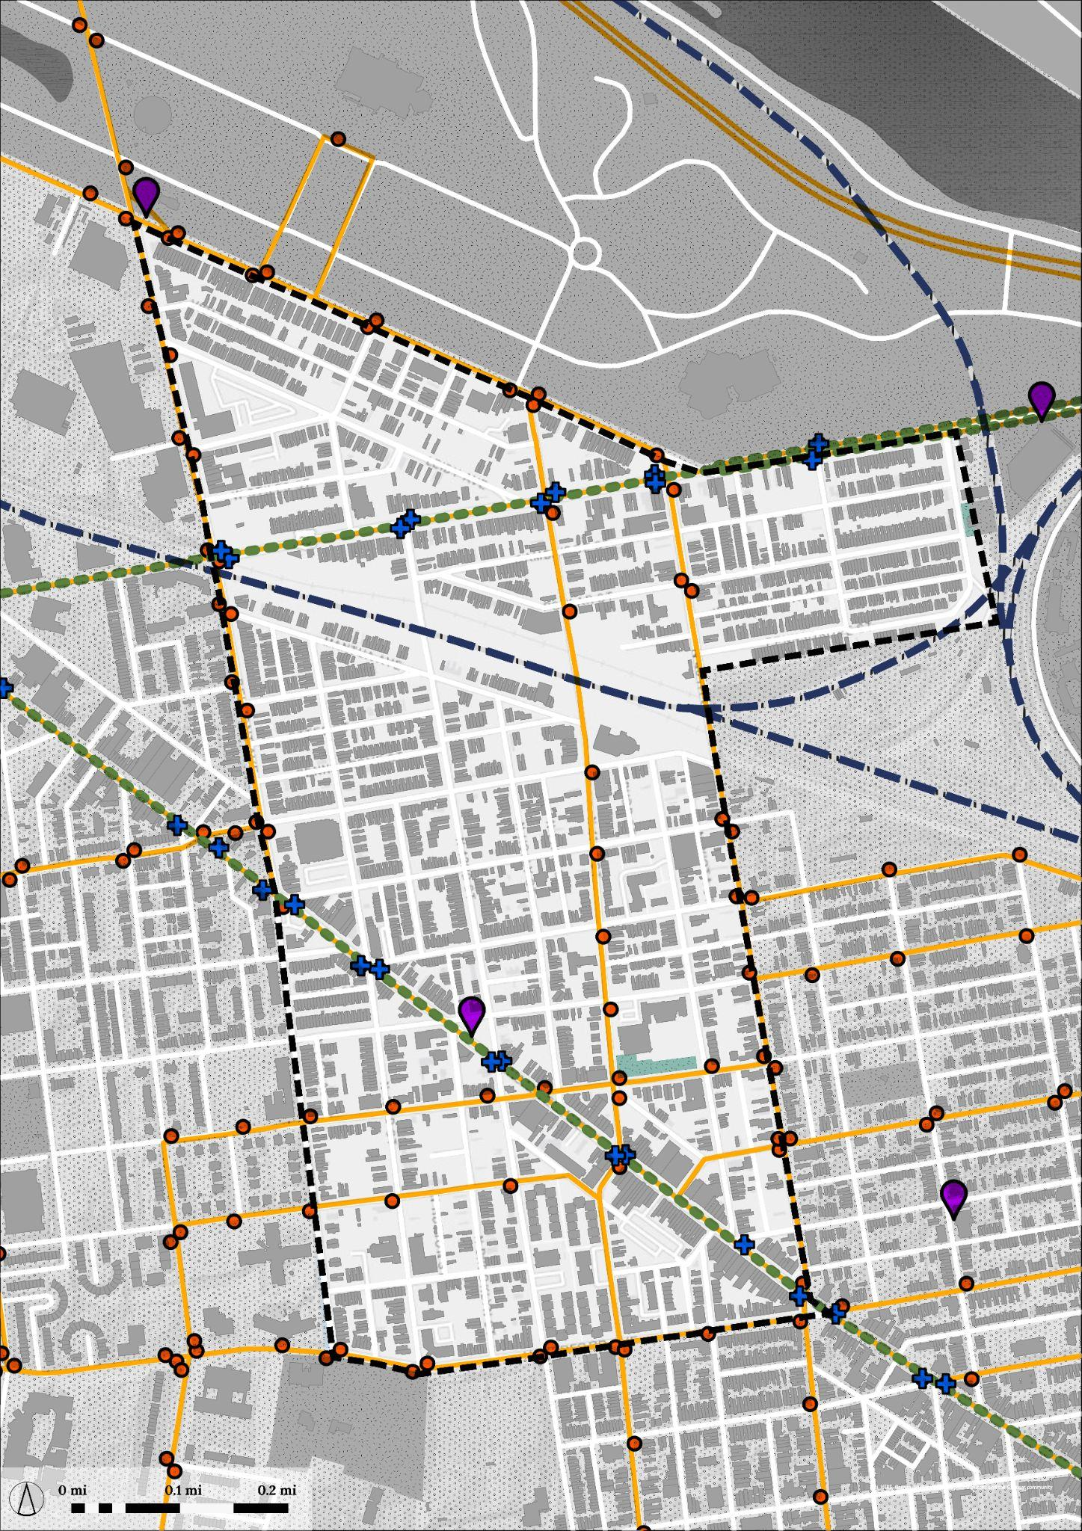
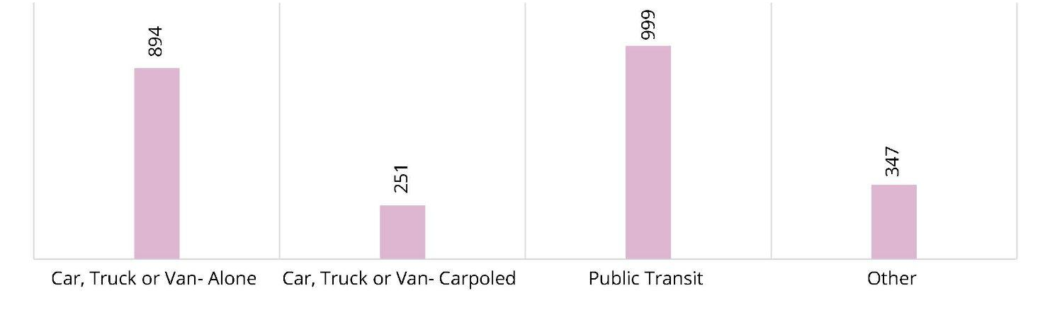



Commuting Characteristics
Modes of Transportation to Work
~40%
of commuters over 16 use public transit.
~36% use cars, and 10% carpool to work.
~68%
Of transit users are female.
121
SEPTA Bus Stops
23
Trolley stops
2
Indego bike stations
Regional Rail
Trolley Route
Bus Stops
SEPTA Bus Routes
Trolley Stops
Indego Bike Stations

Slide 25
Commuting Characteristics
Transit Characteristics
~40%
of commuters over 16 use public transit.
~36% use cars, and 10% carpool to work.
~68%
Of transit users are female.
40, 38, 64
Common SEPTA
Bus routes
10, 15
Common SEPTA
Trolley routes
80%
SEPTA Bus + trolley
On Time Performance
The public transit ridership in Philadelphia (2019, ACS 5-year) is only 25%, which shows that there is a higher reliance on transit in the study area than the city. Looking at the previous slide, we can see that the access to transit is sufficient. However, does an 80% on-time performance of SEPTA indicate the study area is well-served by it?
Regional Rail
Trolley Route
Bus Stops
SEPTA Bus Routes
Trolley Stops
Indego Bike Stations

Slide 26
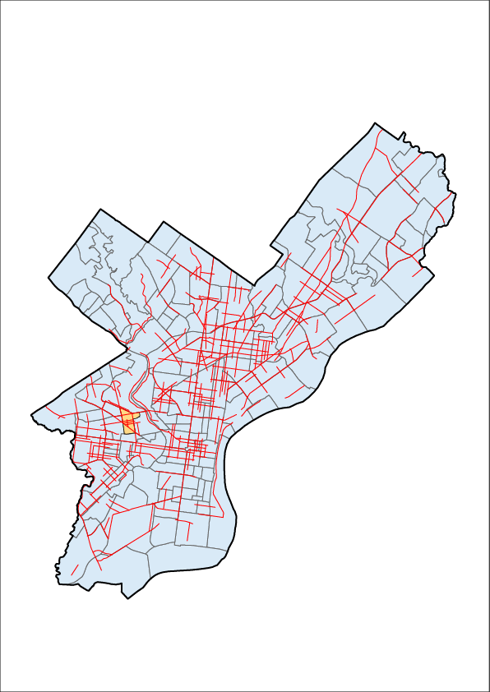
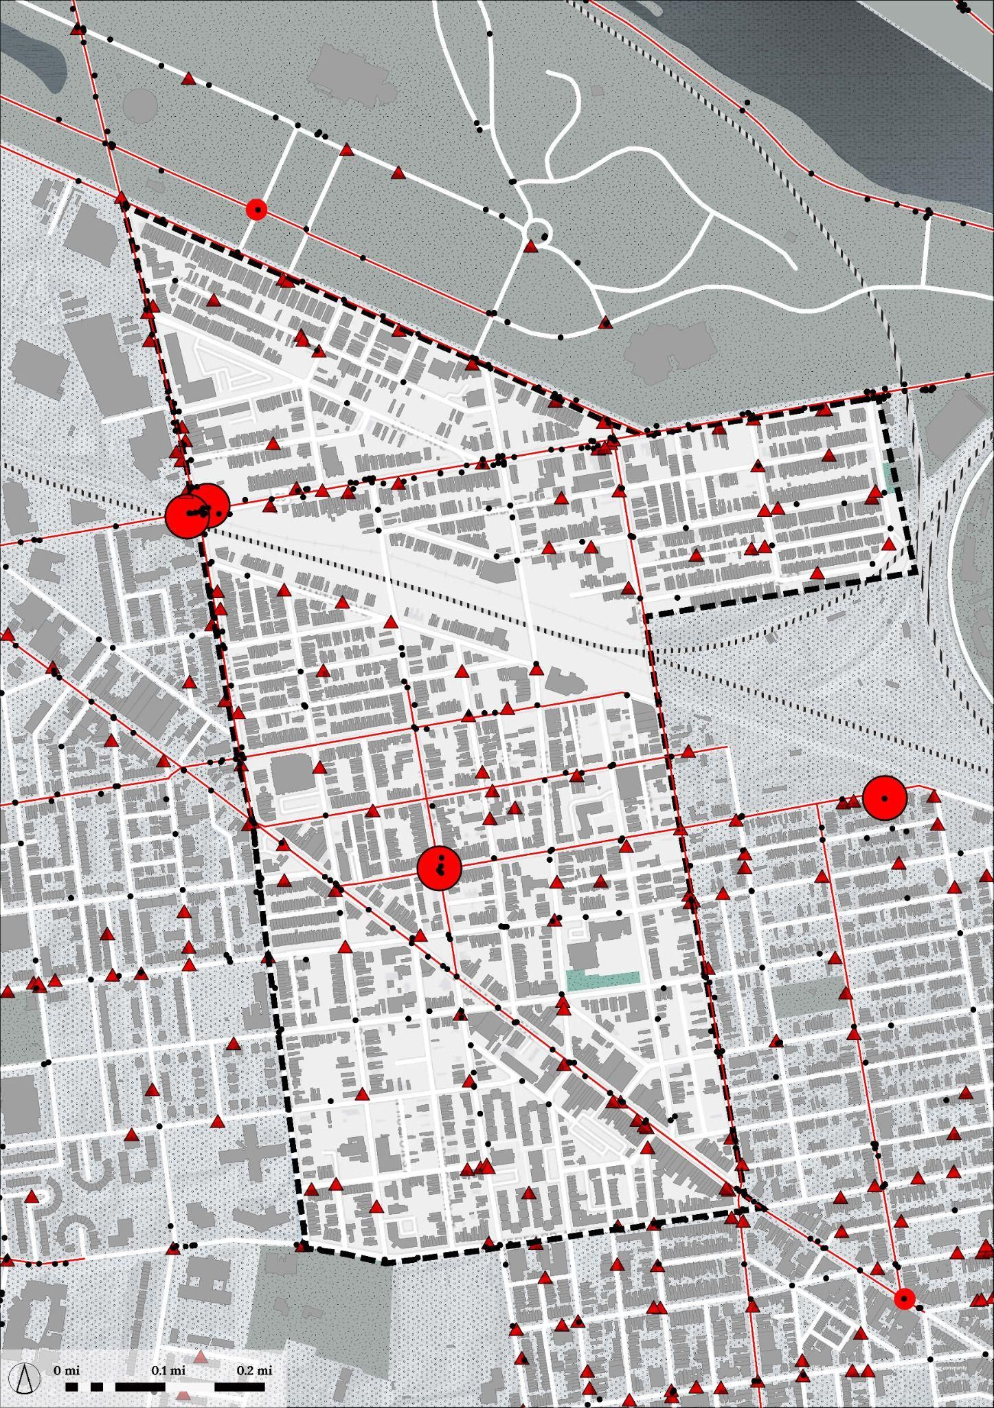
How Safe is the Area?
Crash and Crime Data
134
Vehicle related thefts
~539
Total crashes from 2013-17
4
Fatal crashes from 2013-17
Philadelphia High Injury Network, Vision Zero PHL
High Injury Network
Fatal crash (2013-17)
Crash (2013-17)
Vehicle related thefts
Crash + crime data map

Slide 27
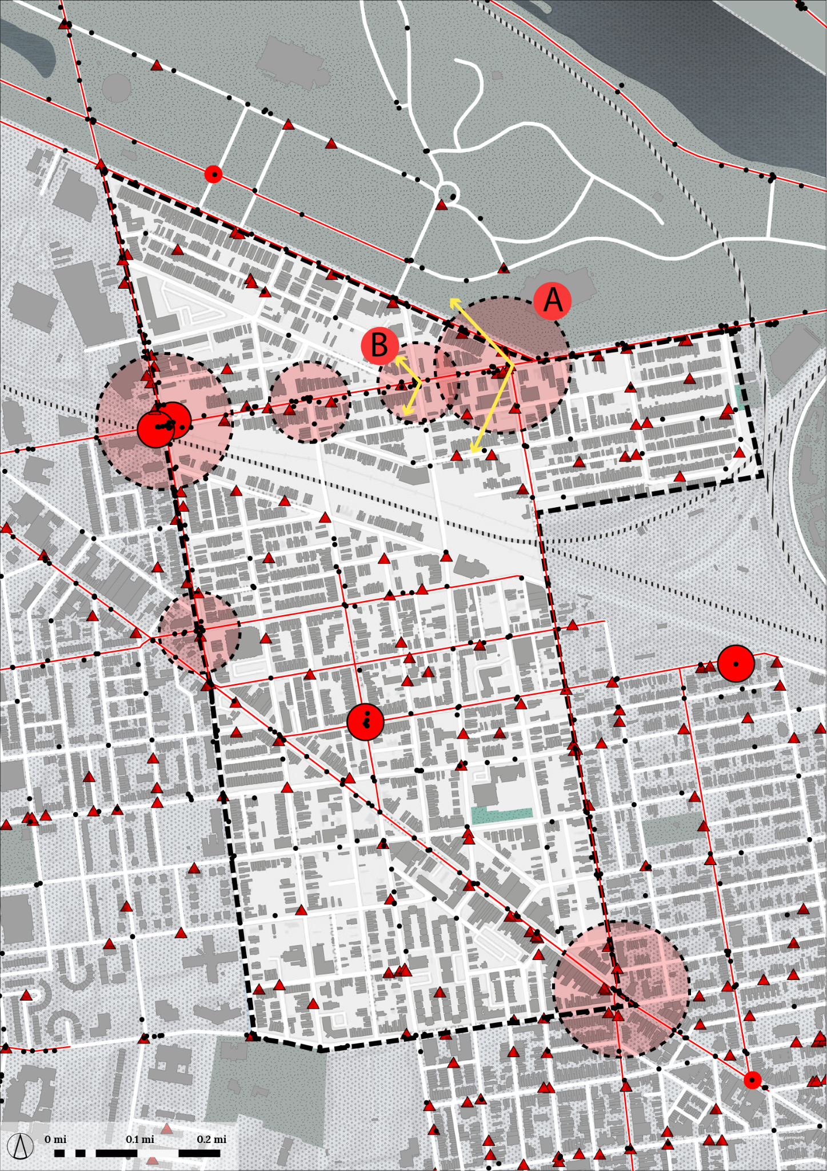
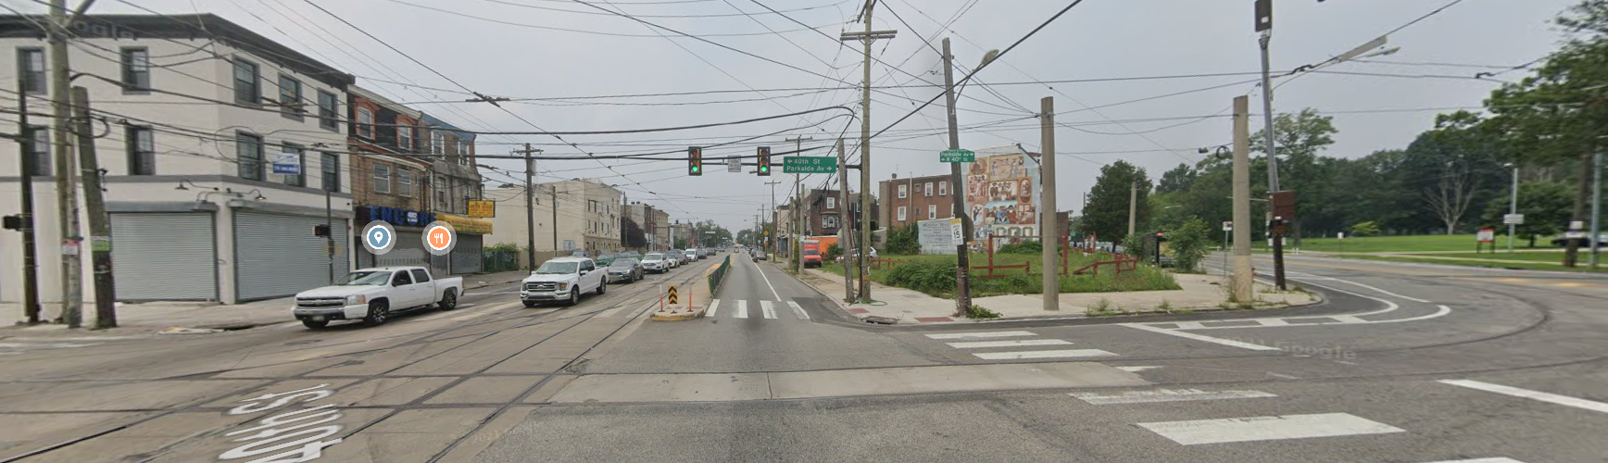
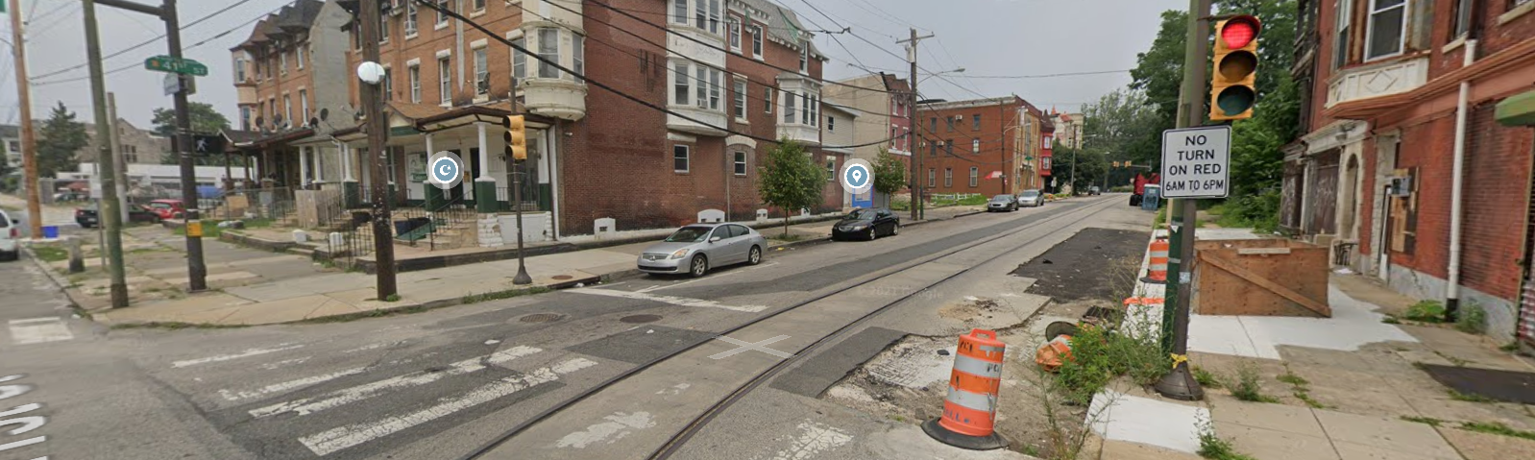
Crash Zones
Visual Analysis
A
Zone A. Looks resolved, buried installed on median island. Also, this street is close to Parkside Avenue.
B
Zone B. High traffic zone with trolley line; unsafe crossing, narrow ROW
Crash + crime data map

Slide 28
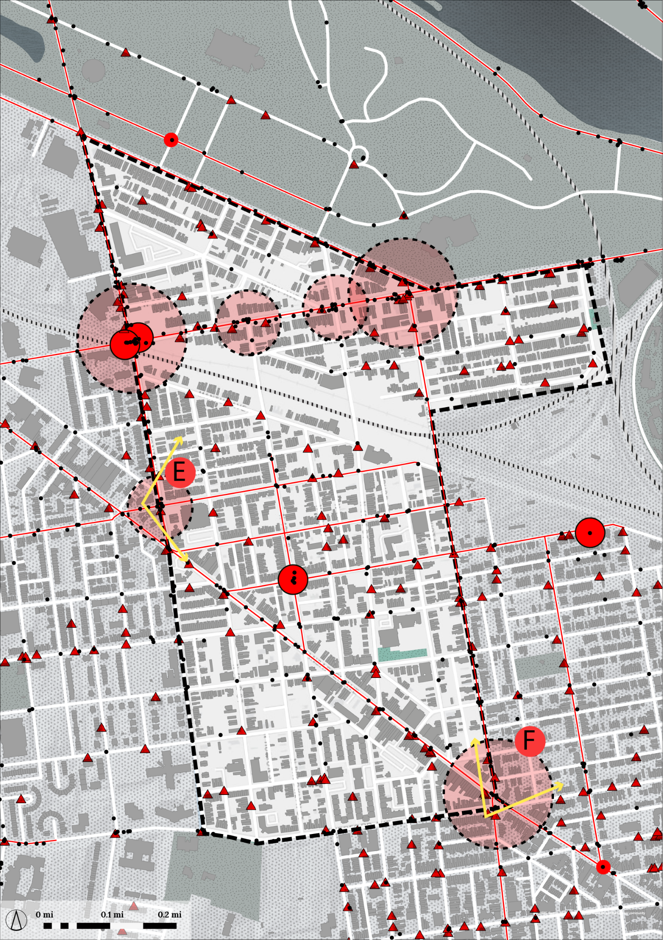
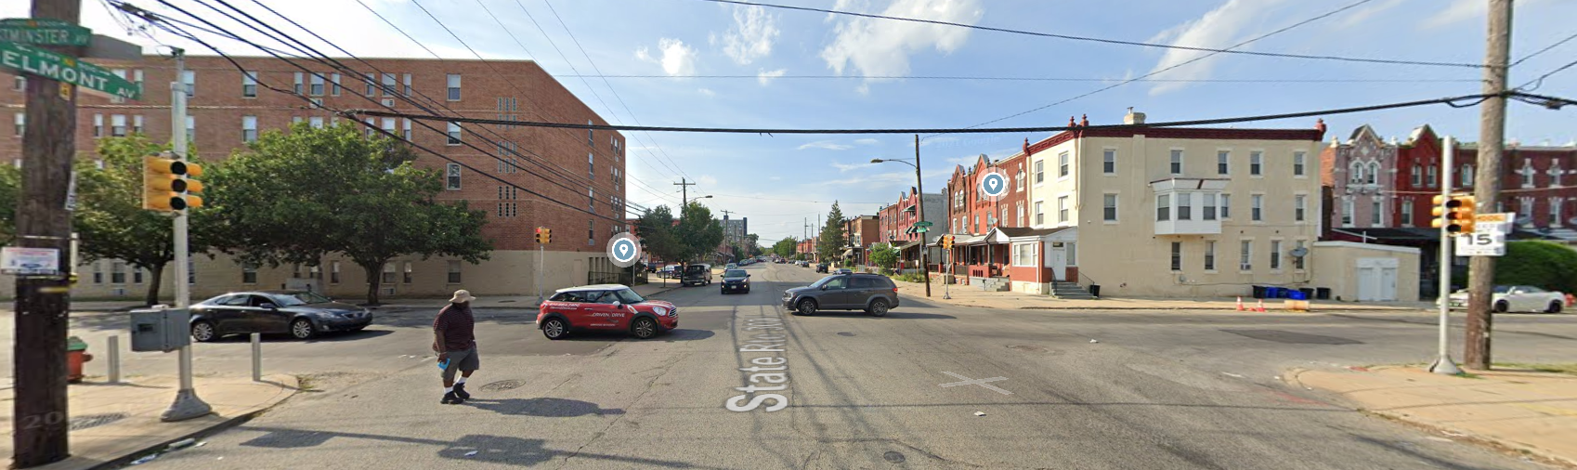
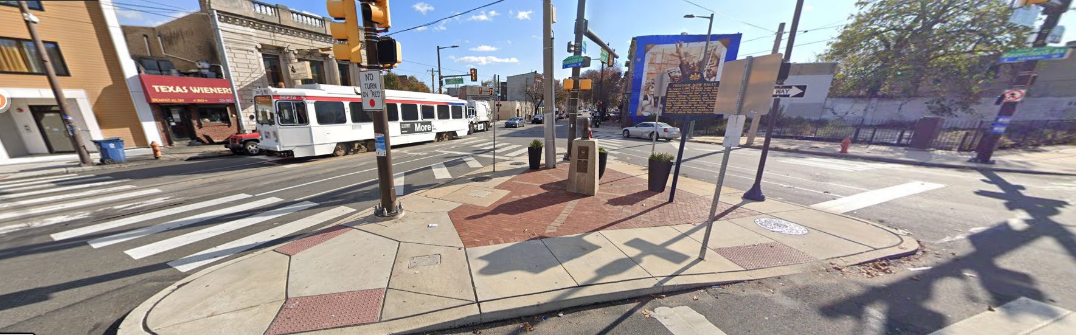
Crash Zones
Visual Analysis
E
Zone E. Road markings faded/missing
F
Zone F. Good pedestrian island for safe crossing + cultural heritage elements
Crash + crime data map

Slide 29
Land Use and Built Form

Slide 30
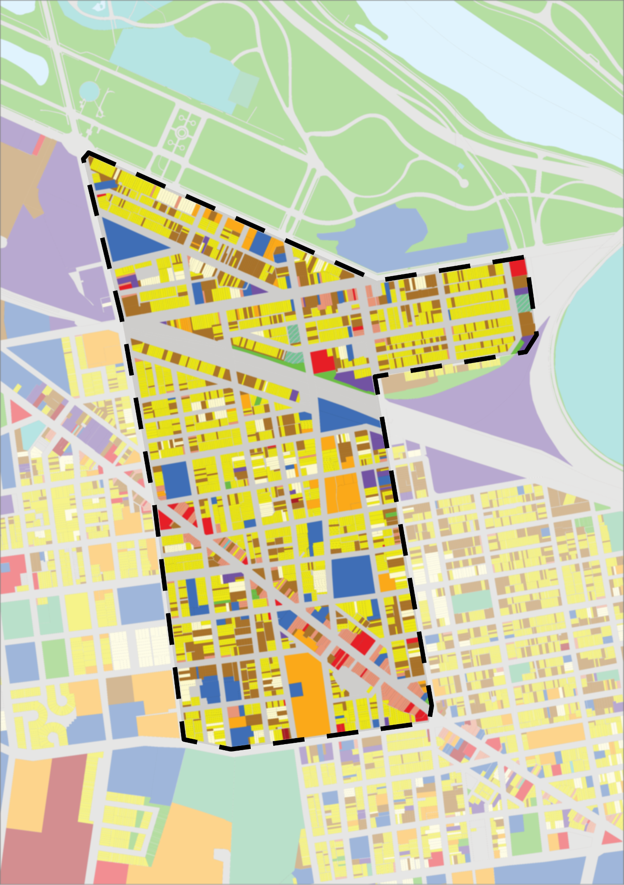
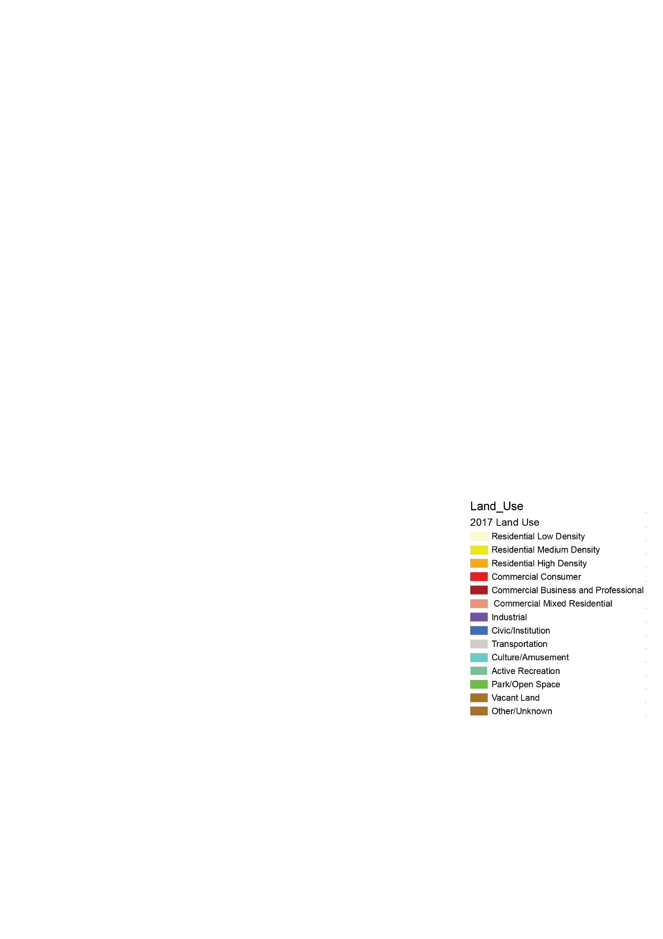
Predominantly Residential Area with Large Vacant Space
Land Use
~34%
of the land use area is Residential, with medium density residential accounting for 75% of the total Residential land-use area
~5%
of the land-use area
is Commercial.
~12%
of all properties
in the area are vacant.
~4%
of the land use
is Industrial
~6.5%
of the land use
is Civic/Institution
Our study area is predominantly residential in character and is lacking in major job centers.

Slide 31
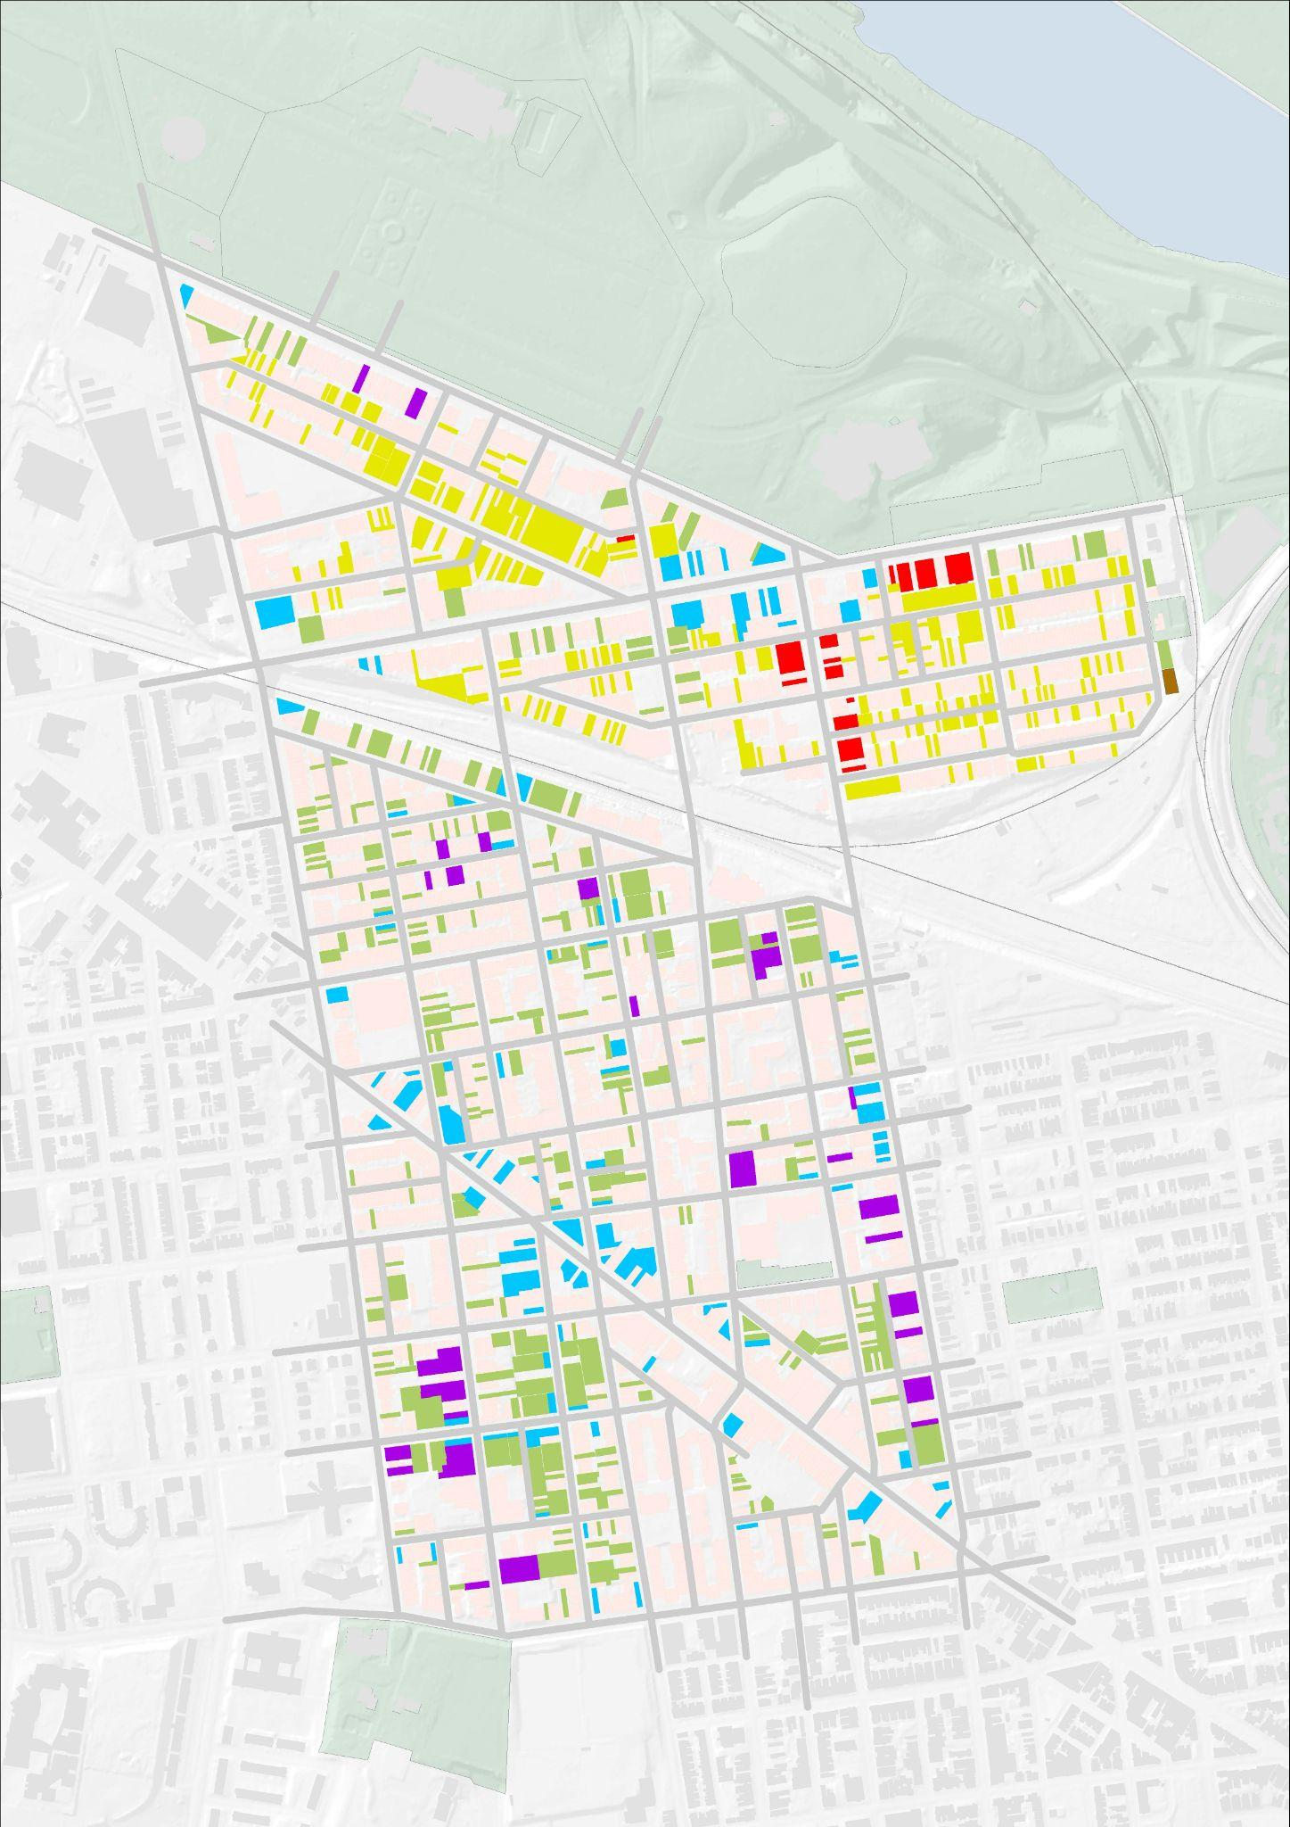
Predominantly Residential Area with Large Vacant Space
Vacant Lots
East Parkside contains the majority of the vacant plots.
15.5% of the vacant parcels belong to PHA, Philadelphia Land Bank as well as Parkside Redevelopment
84.5% are owned by individuals or private developers/LLC.
12%
Vacant
160
Vacant Land Parcels
Semi-detached Housing
Multi-Unit Residential
Small scale commercial
Semi-detached Housing
Retail
Light Industrial

Slide 32
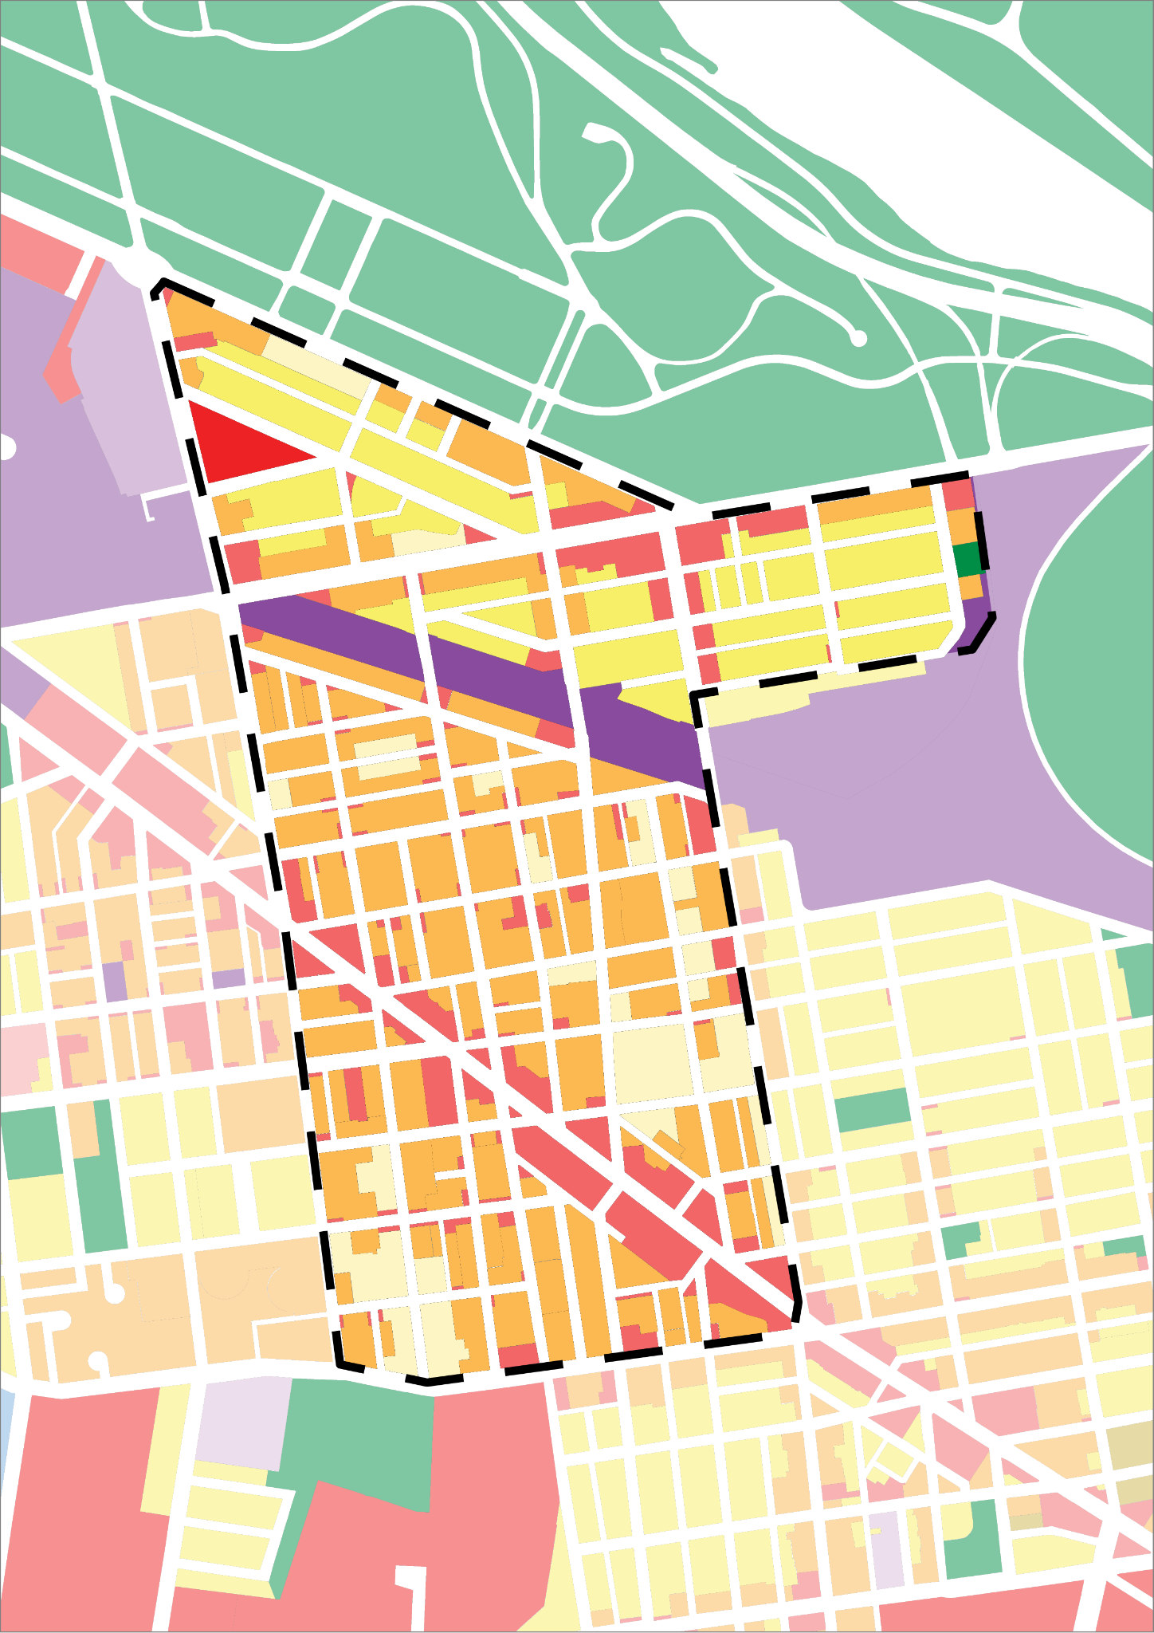
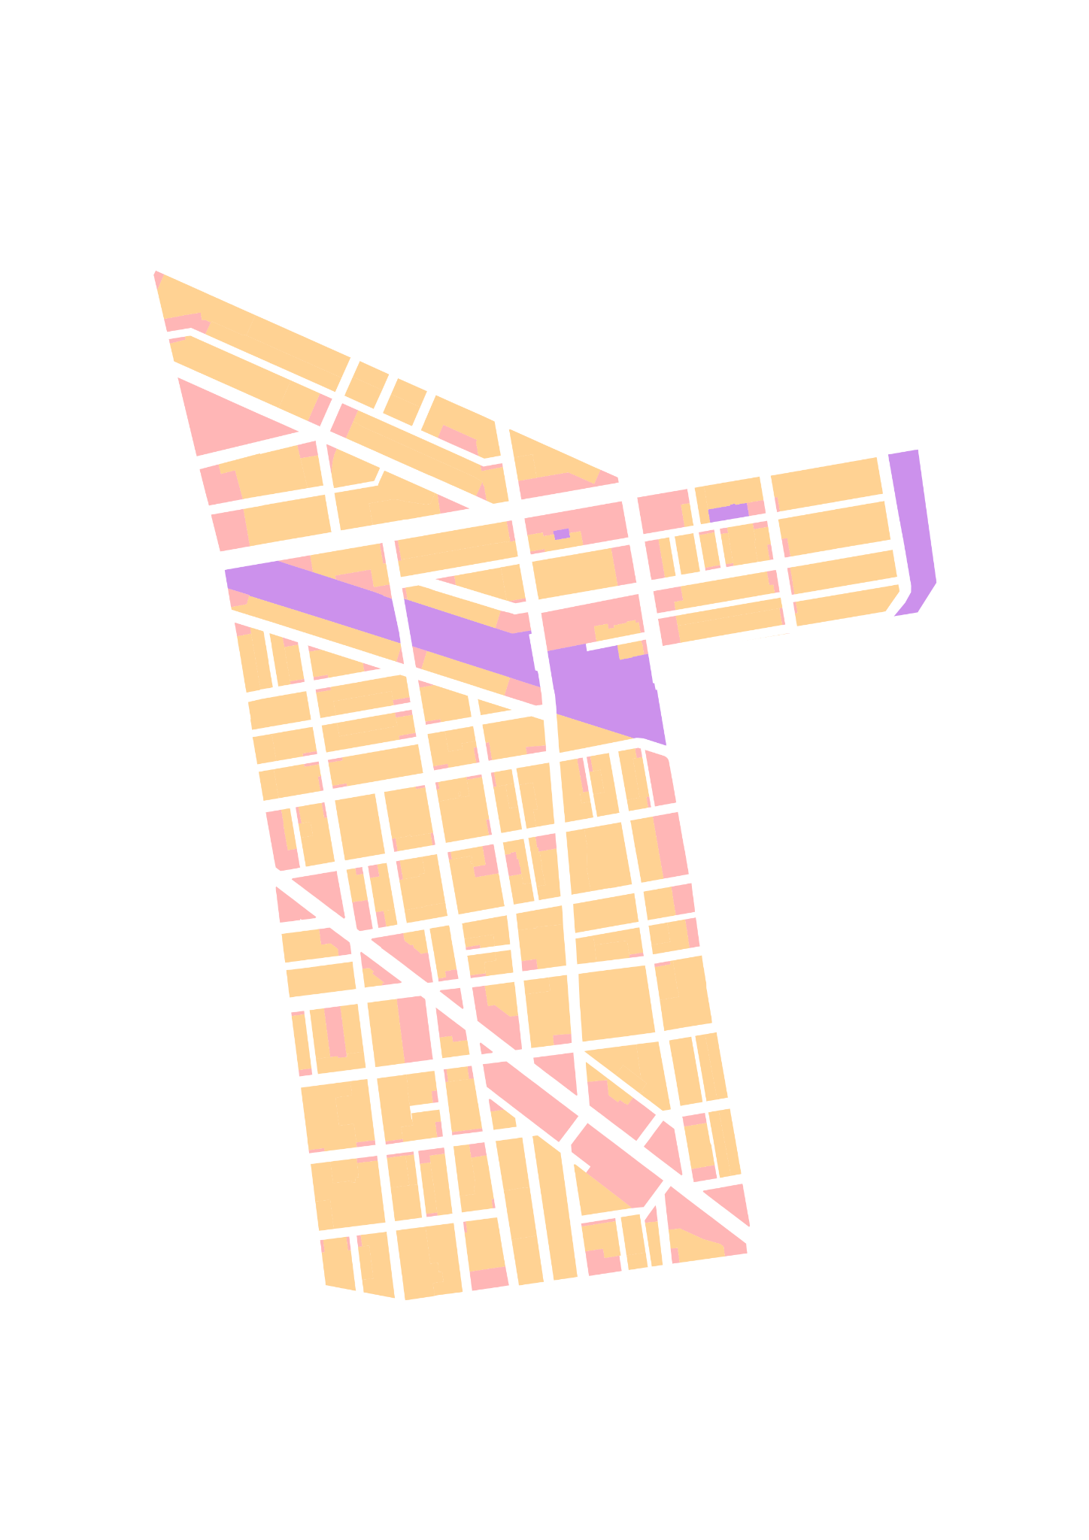
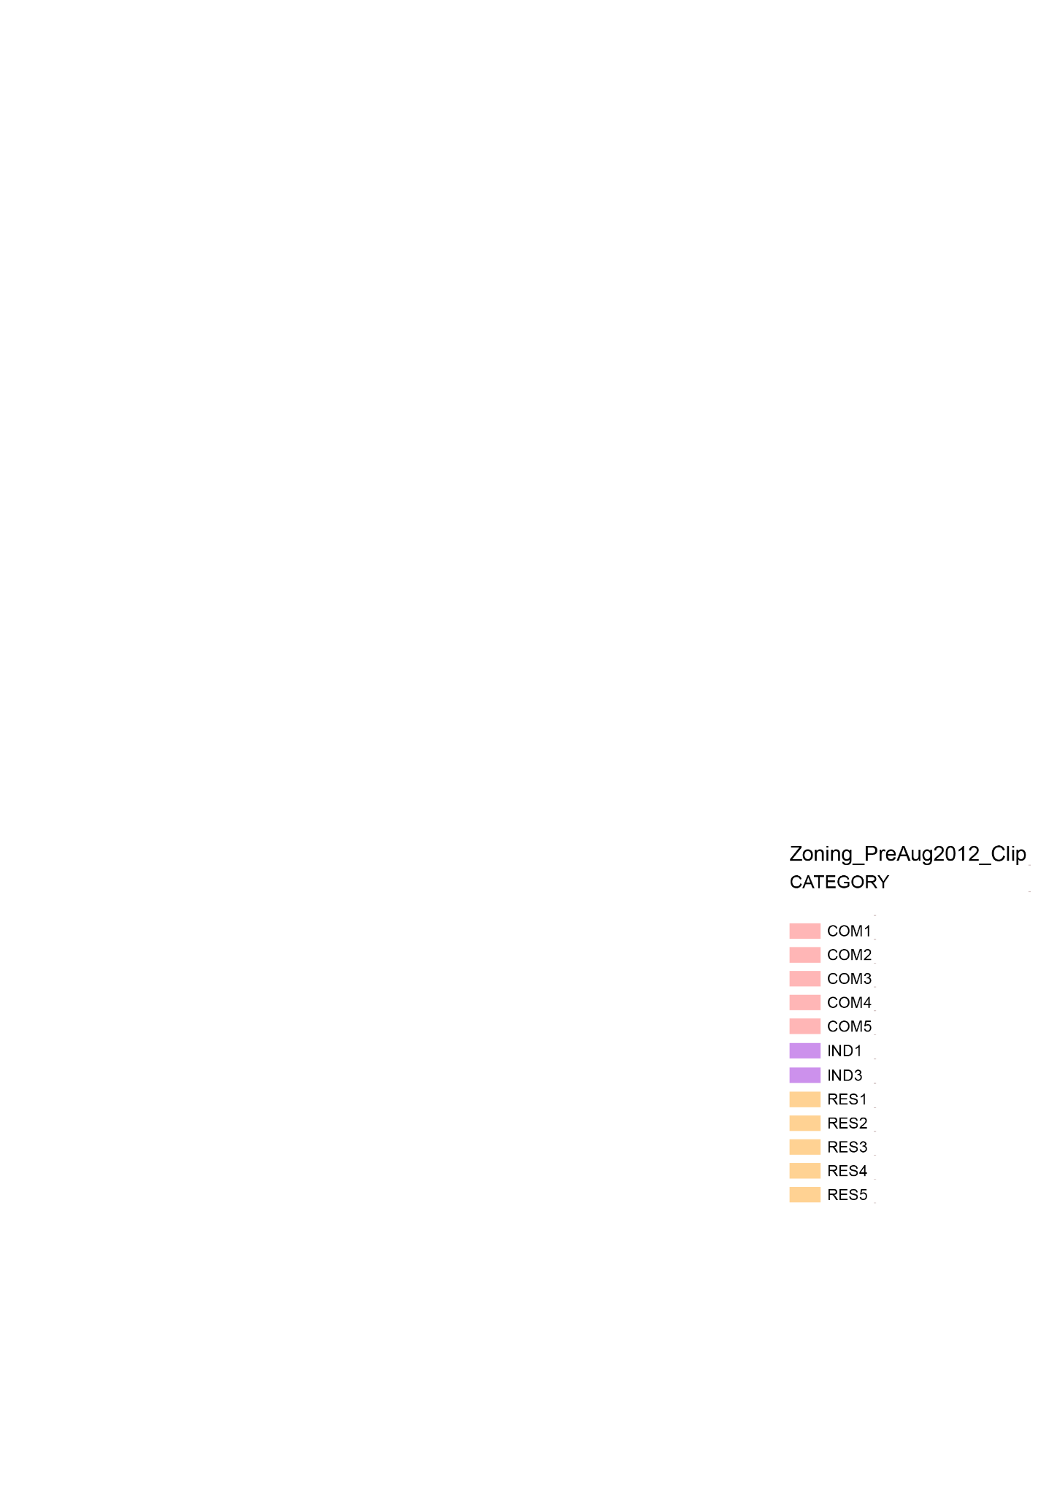
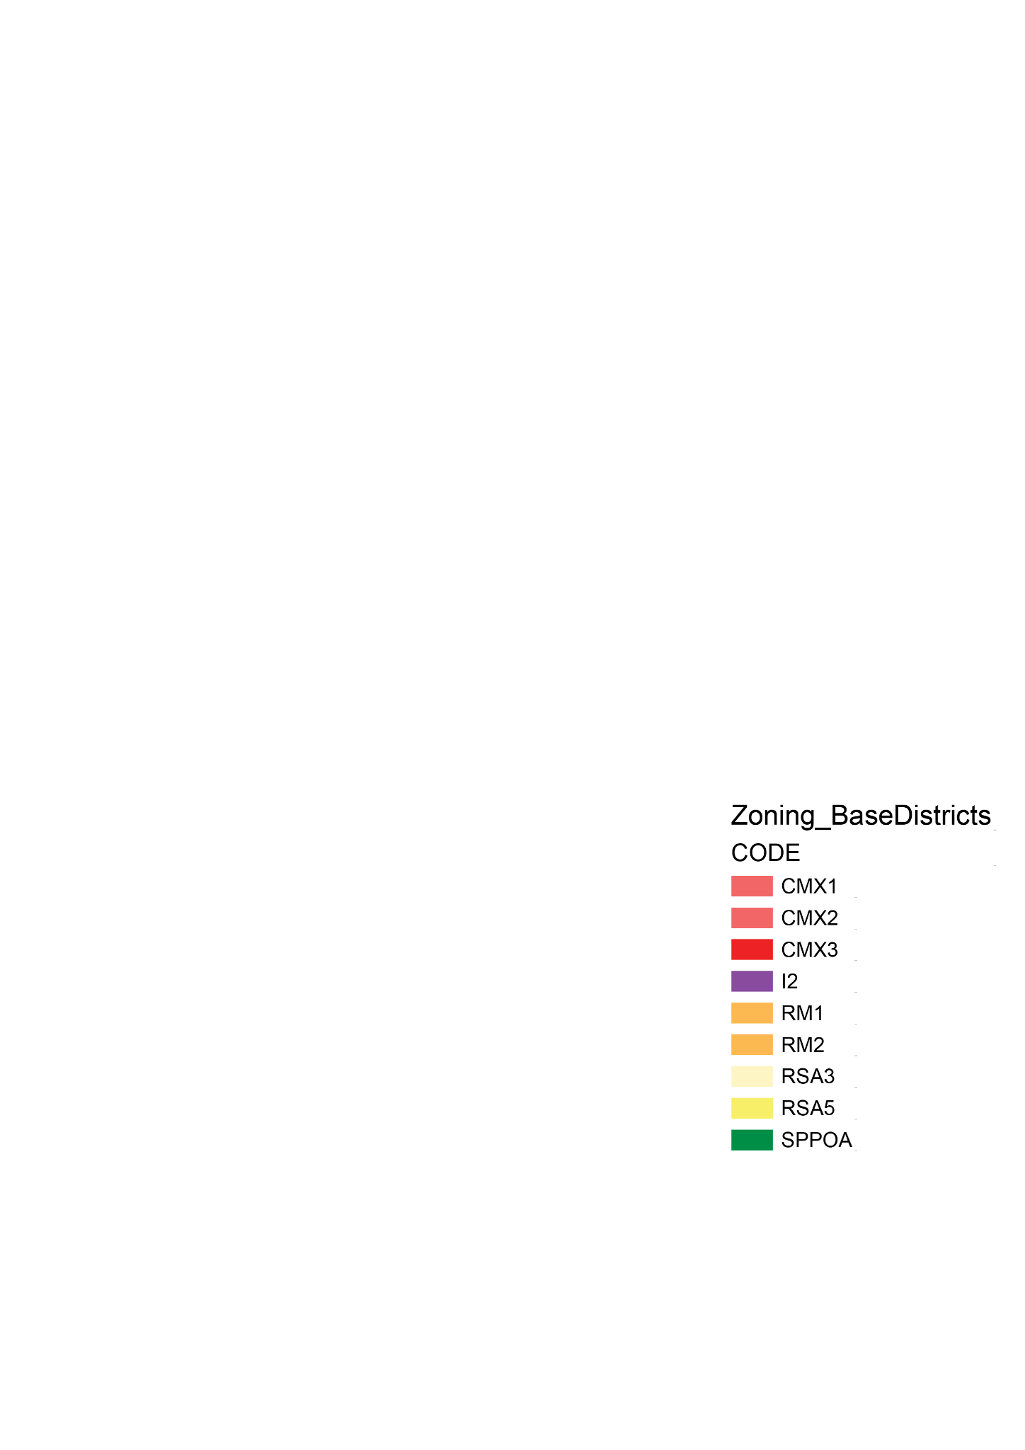
Predominantly Residential Area with Large Vacant Space
Zoning
East Parkside
>23%
of the land area in the district is Residential Single Family housing
>35%
of the land area in the district is Multi-Unit Residential
Belmont
>13%
of the land area in the district is Retail
2012 Zoning map
2012
2017
Haverford North

Slide 33
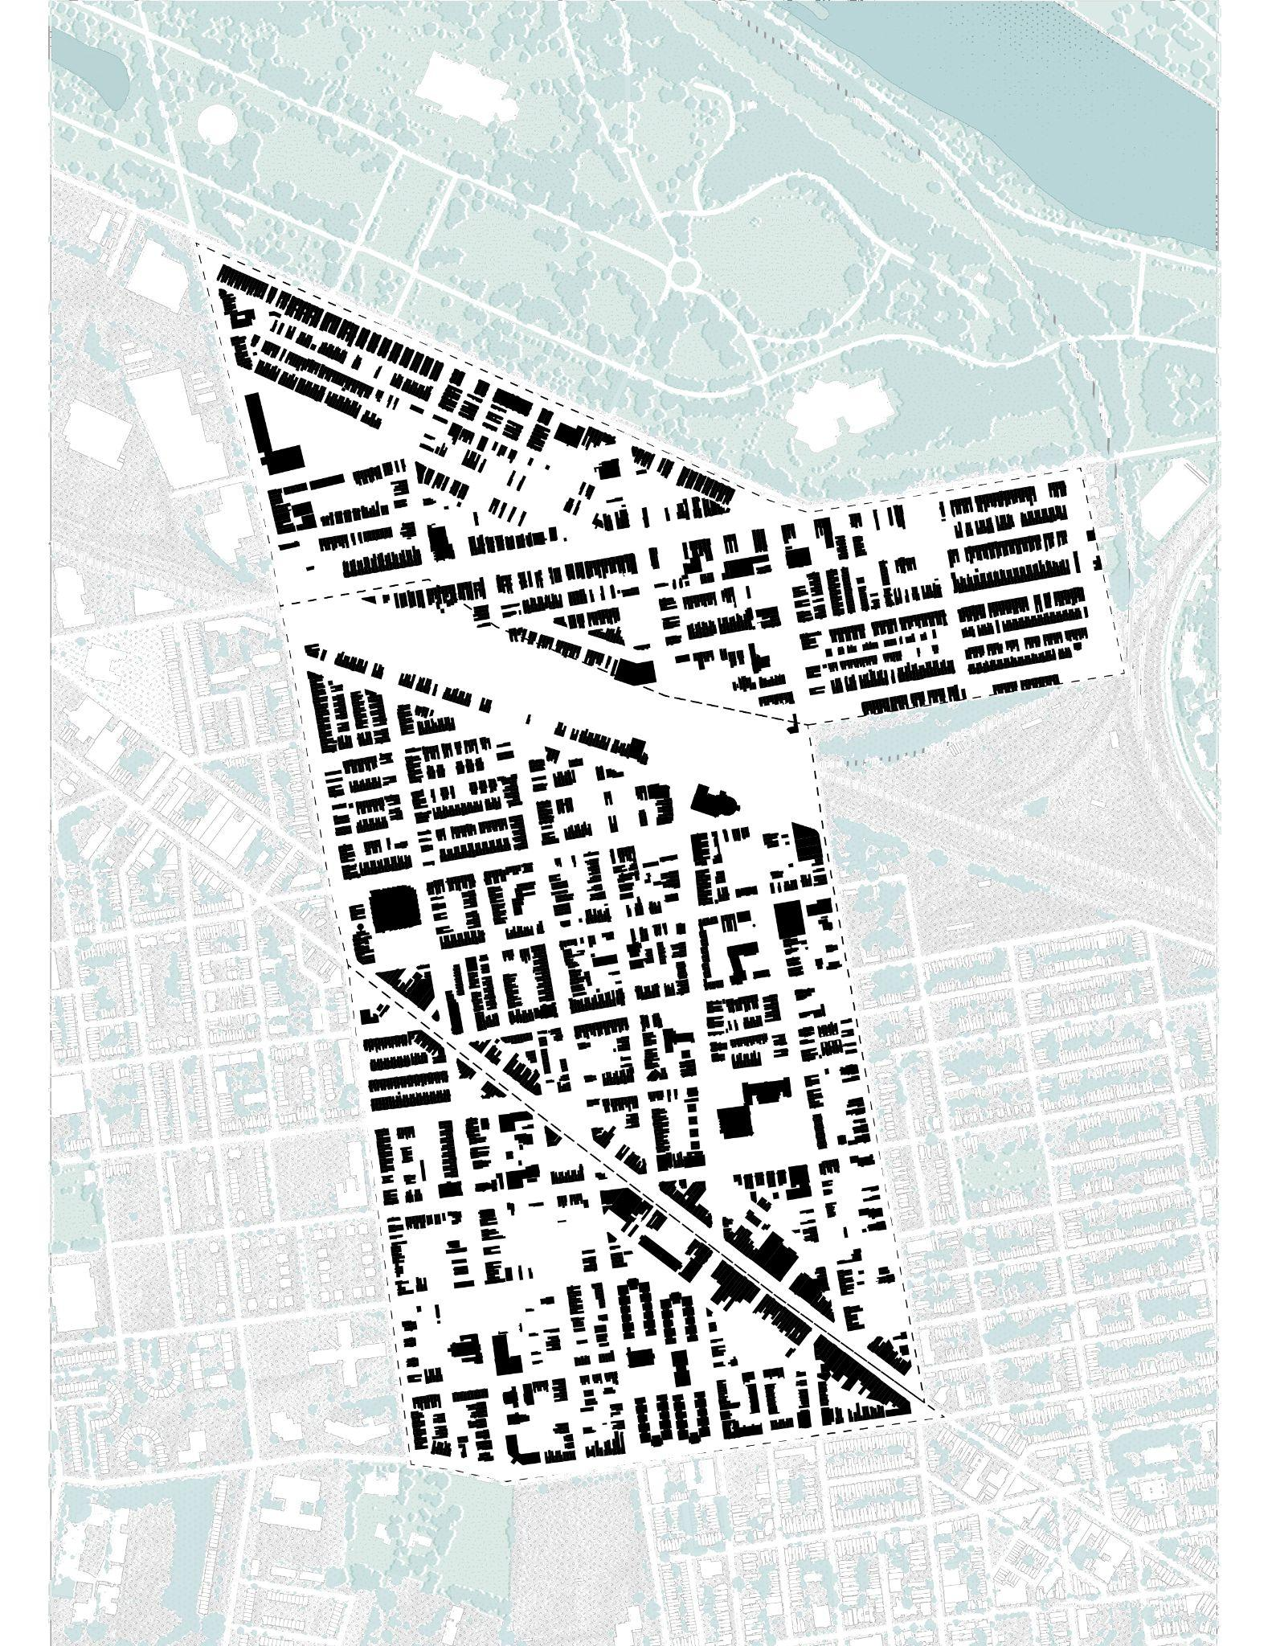
Figure Ground
Built-Open Ratio
The figure-ground analysis reflects the build to open ratio of the three neighborhoods. Open areas include streets, parks, and public plazas. Although the open constitutes around 72% of the total area, only one community park is present. The study area has no registered Community Gardens and only one community park.
72%
Open
28%
Built
Nolli map

Slide 34
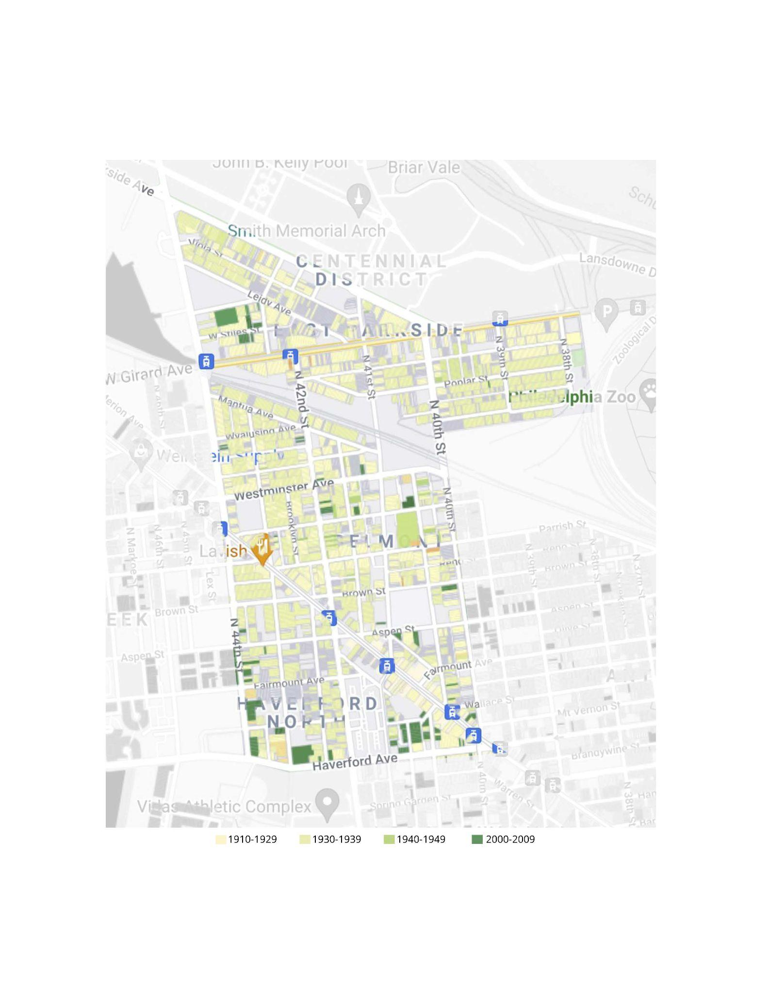
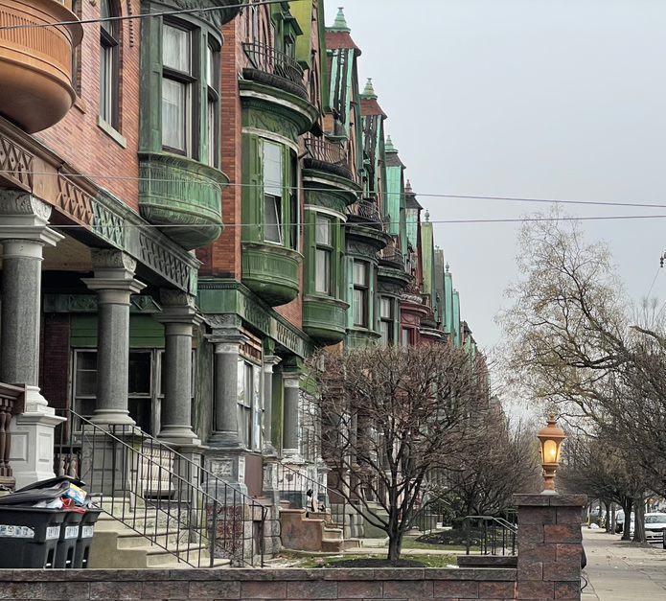
http://www.campusactivism.org/philly/houseage.php
Historically-Rich Building Structures
Land use
ADD EAST PARKSIDE
HISTORIC HOMES PHOTO
HERE
51%
Built before 1939
1983 - Parkside Historic District placed on the National Register of Historic Places
“People can afford to pay taxes...but they can’t afford upkeep”
Lorraine Gomez,
Centennial Parkside CDC founder

Slide 35
Conclusion

Slide 36
Looking Ahead
Expected Trends: Issues and Opportunities
Economic Diversity
Land Activation
Education Cuts
Housing Rehab
Traffic & Pedestrian Safety
Aging Population

Slide 37
Q & A

